Slide 1
Robert Dugan, PCWA
Placer Business Alliance
October, 2021

Slide 2
Serving Our Customers:
Reliable, safe delivery of potable water
Balanced cost of service that includes renewal & replacement
Responsiveness to our customers – including new customers (developers)

Slide 3
This Year – 2021 Drought:
Full Delivery for Agriculture
Full Supplies for Residential, M and I Customers
Backfilling Regional Agencies’ Needs
Helping Folsom
Helping the Lower American
Helping the Central Valley

Slide 4
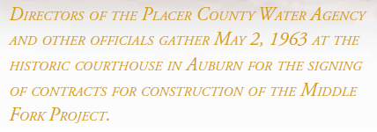
To Understand Our Present You Have To Understand Our Past

Slide 5
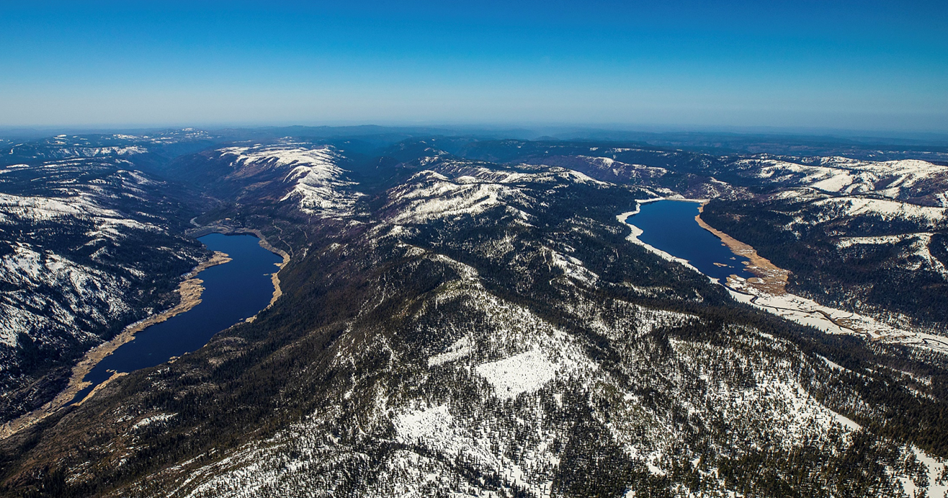
To Understand Our Present You Have To Understand Our Past

Slide 6
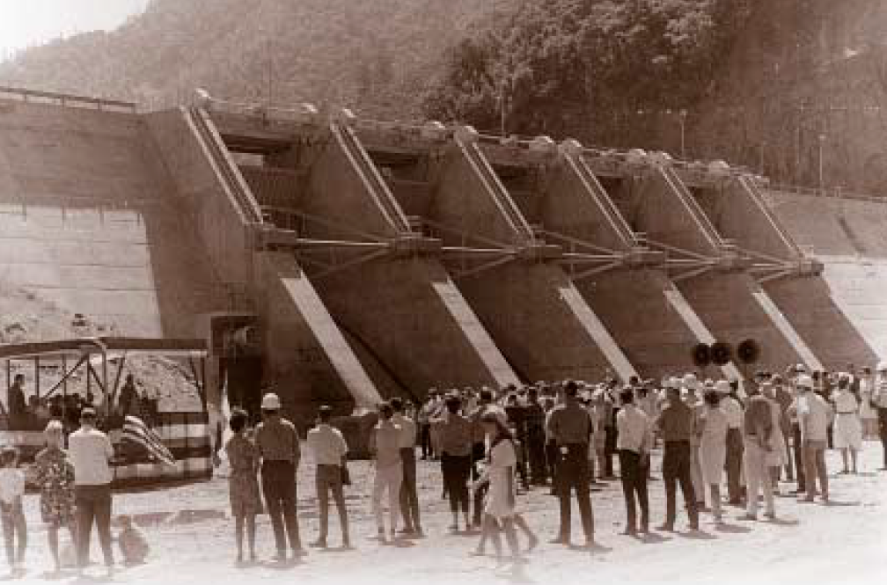
To Understand Our Present You Have To Understand Our Past

Slide 7
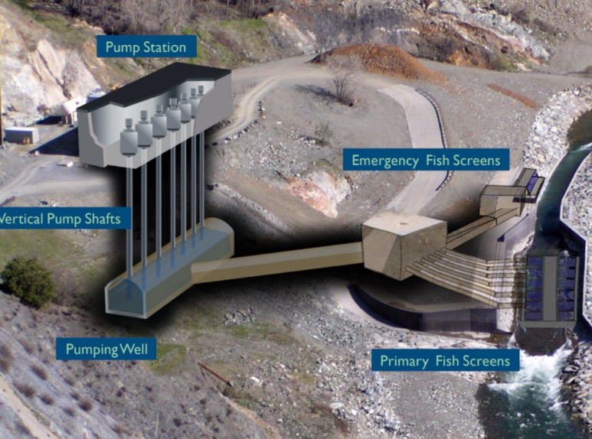
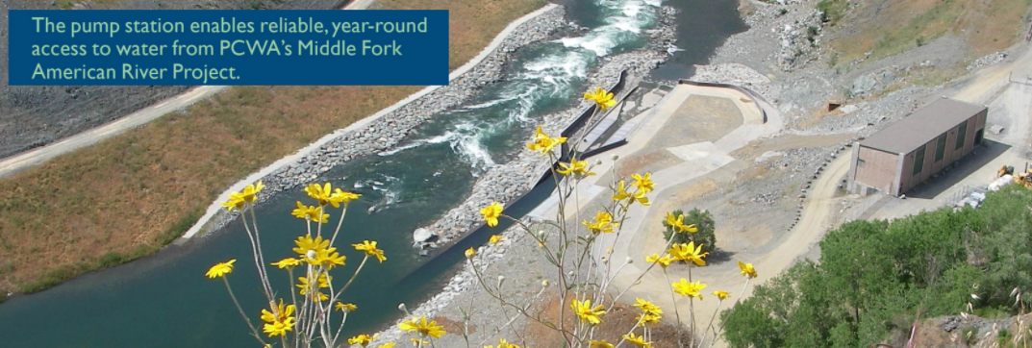
To Understand Our Present You Have To Understand Our Past
Auburn Pump Station
Notes:
Completed in 2008.

Slide 8
Planning for the Future:
Water supply to new communities
Account for development plans in our UWMP and in our infrastructure plans
Constantly anticipating drought and supply reliability issues
Partnerships with Cities of Roseville and Lincoln for centralized water delivery infrastructure (these are both Ophir WTP and RiverArc)

Slide 9
ALWAYS Honoring the Past by Planning for the Future:
Drought
Water Forum
We are tightly bound to Roseville and Sacramento in our strategic planning and drought response efforts.
We are working through local partnerships to develop balanced solutions: RWA, NCWA, and the Water Forum
Key solutions: Managed Headwaters, Water Banking (If you can’t store it white, you have to store it wet) and RiverArc (shifting away from the LAR and providing for conjunctive use)

Slide 10
What’s Up With the Drought?
Climate change will degrade our snowpack 50-75%
2021 Snowpack plummeted from 92% of normal in March to near zero percent by the end of May
This year’s near-average snowpack evaporated or soaked into the soil rather than flowing “running off” into reservoirs
Notes:
Because of driest soil conditions of record, 90% of normal snowpack resulted in 30% of normal runoff (percentages rounded).

Slide 11
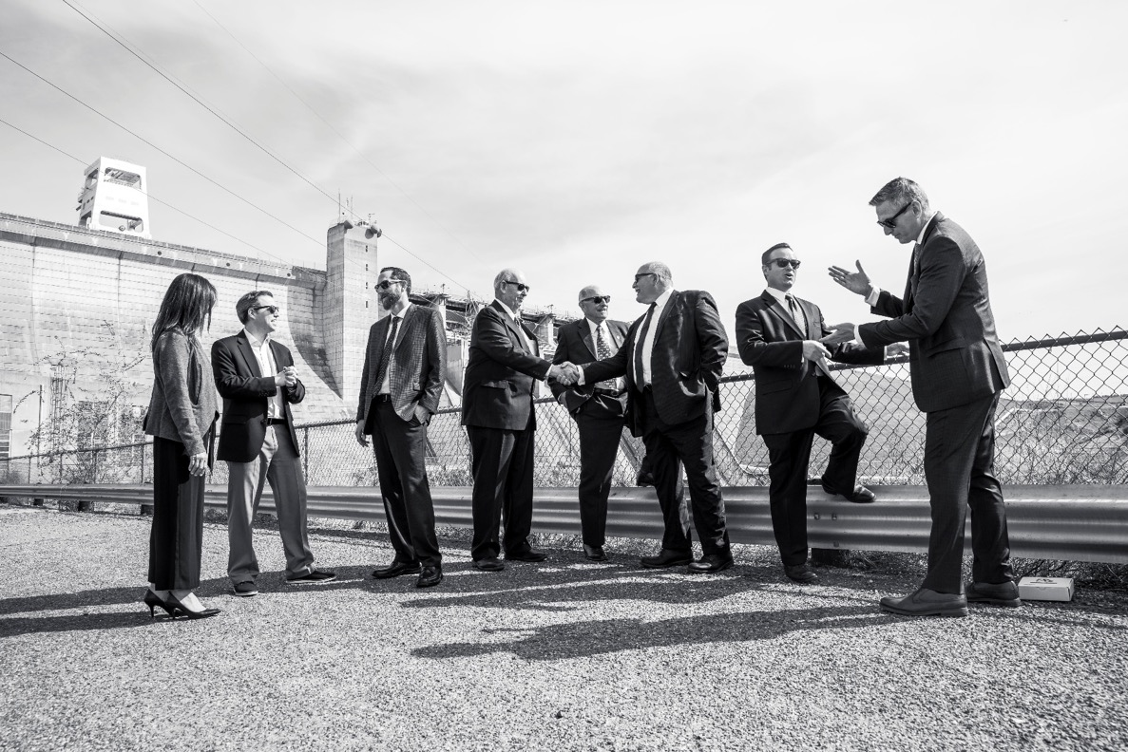
To Understand Our Future You Have To Understand Our Present

Slide 12
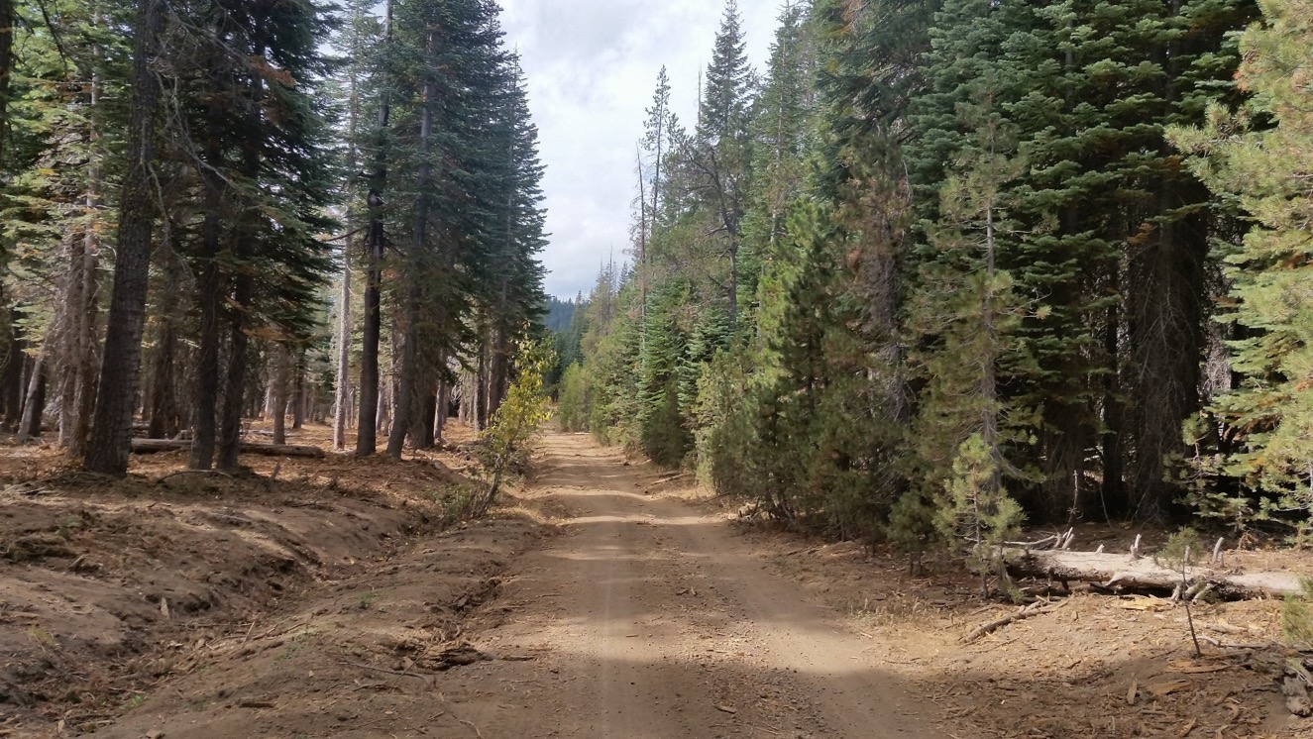
To Understand Our Future You Have To Understand Our Present

Slide 13
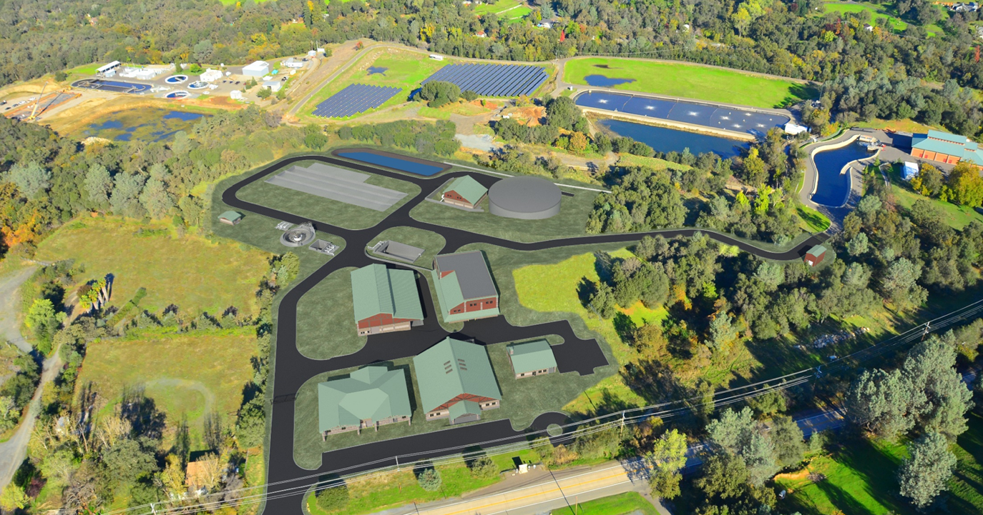
Guaranteed Capacity to Serve Placer County
Notes:
.

Slide 14
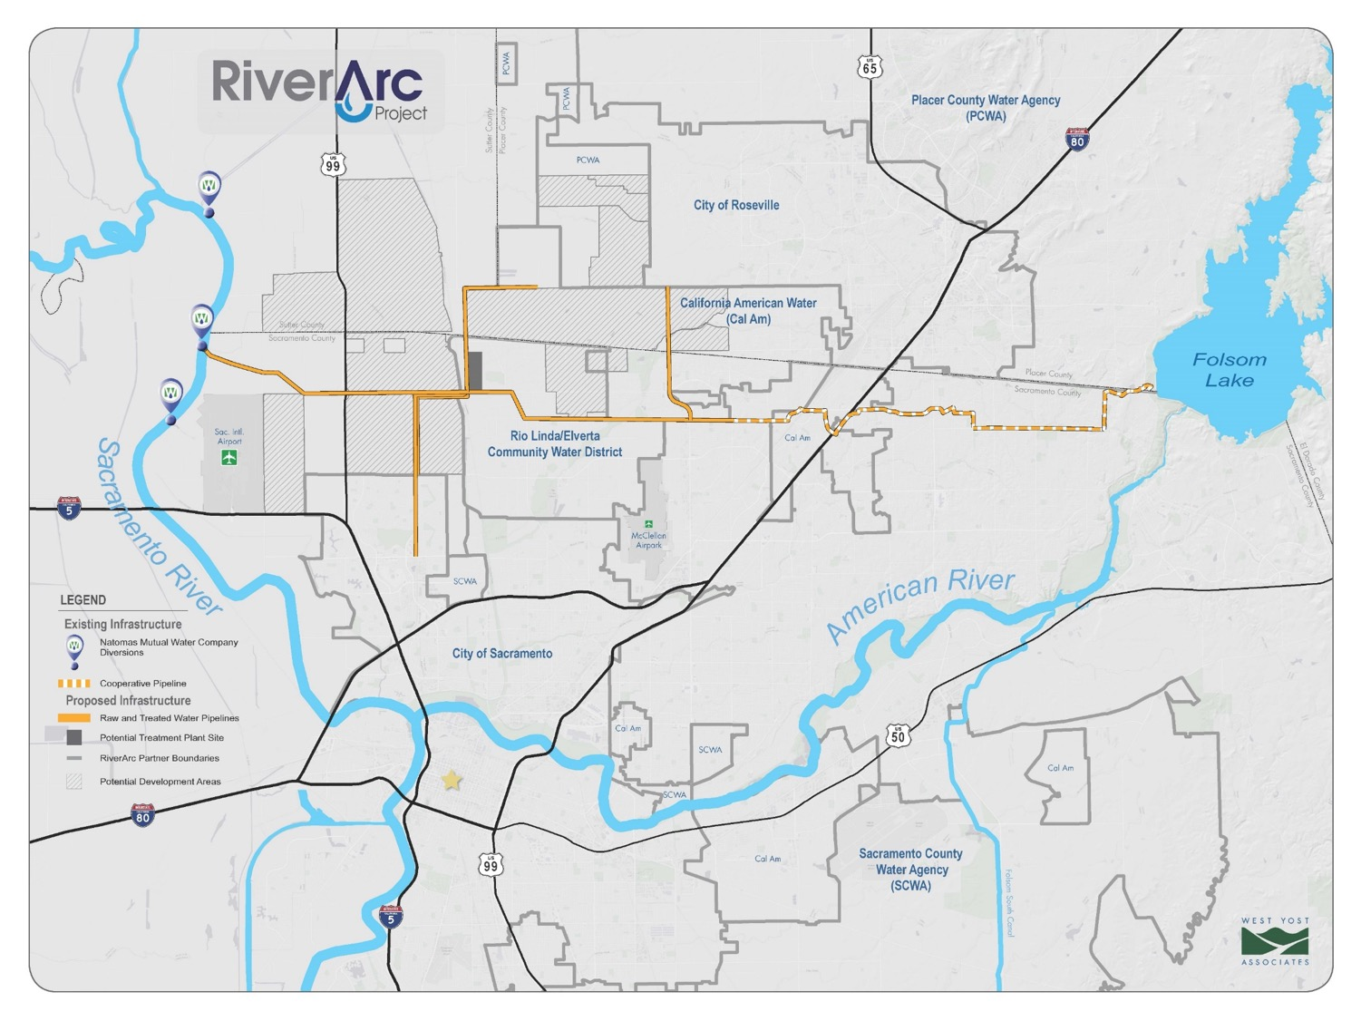
Thank you!

Slide 15
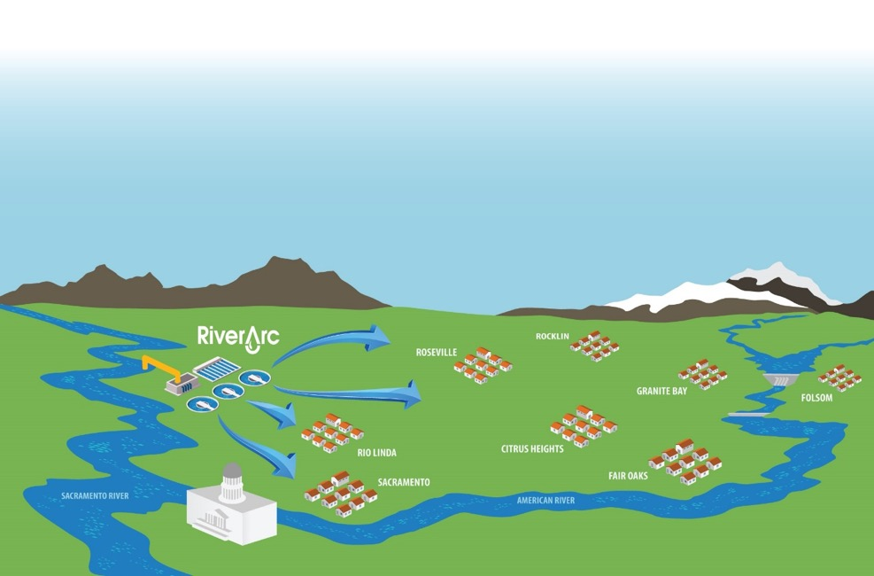
Resilience Projects
Projects
$140 Million in Phase 1
$1 Billion at buildout

Slide 16
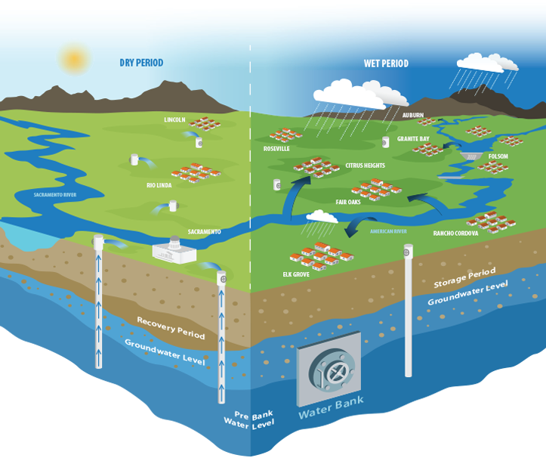
Resilience Projects
Projects
$288 Million over 10 Years
Wells, Interties, Pipelines

Slide 17
Our Watershed

Slide 18
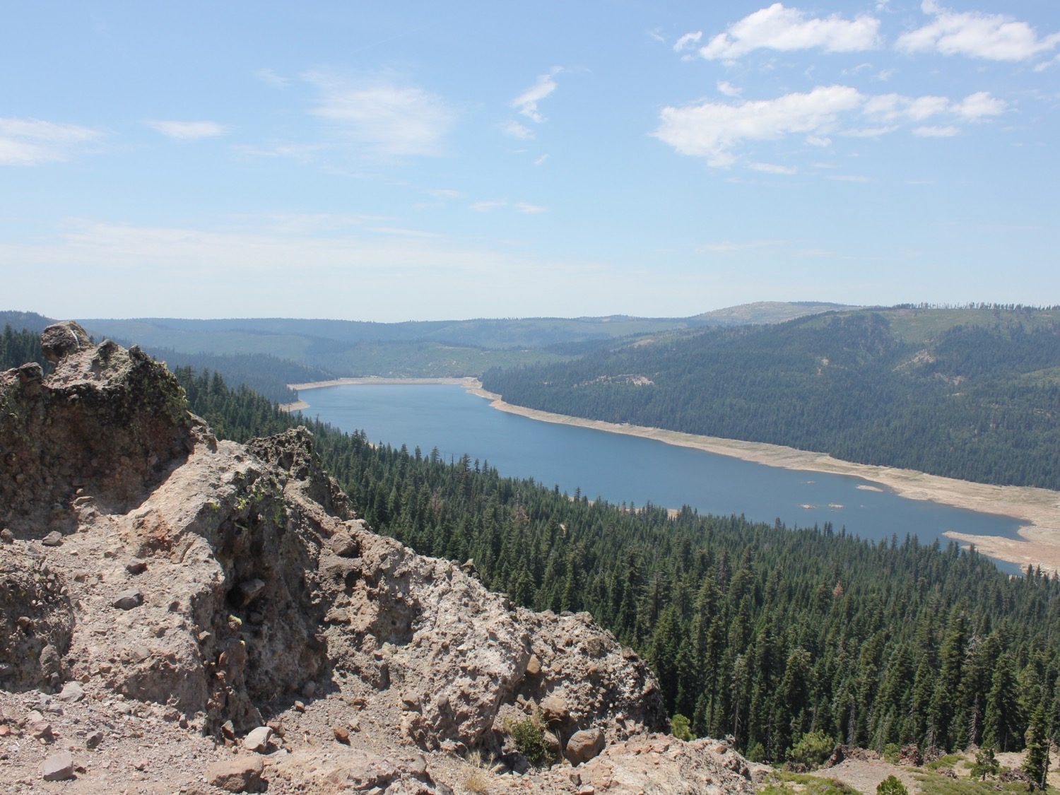
Thank you!
www.pcwa.net

