Slide 1
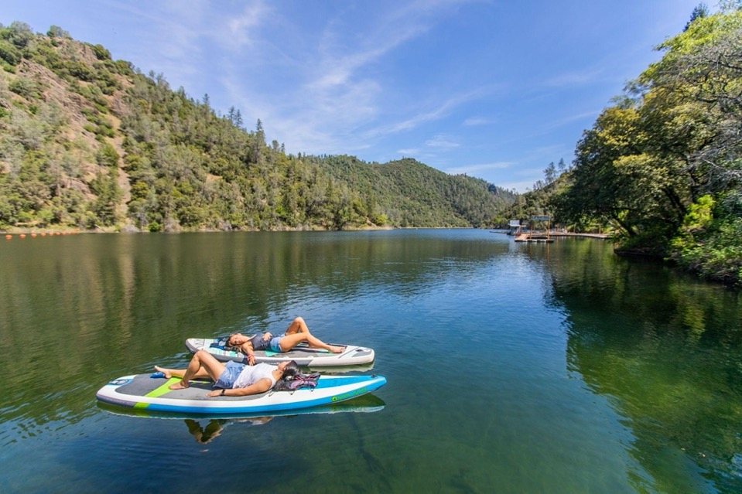
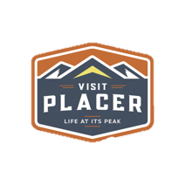

Slide 2
For those who want to breathe easy amidst breathtaking beauty, Placer County, from the Sacramento Valley to the Sierra Nevada along I-80, is where California reaches up to Lake Tahoe and outdoor adventure reaches every interest in every season.
--North Star Research and Strategy Report 2019

Slide 3
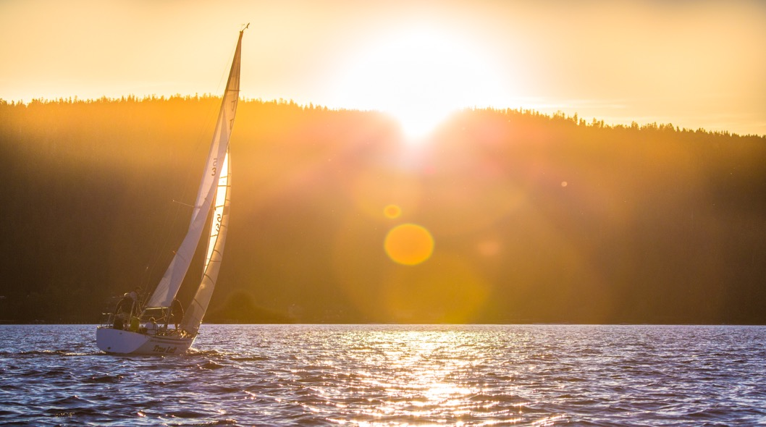
The Placer County Lifestyle
Rated 2nd in the State in Health Metrics*
35th Healthiest County in the U.S.**
*2021 County Health Rankings for the 58 Ranked Counties in California | Source: Robert Wood Johnson Foundation 2021
**Healthiest Counties in the US | US News Healthiest Communities. https://www.usnews.com/news/healthiest-communities/rankings.

Slide 4
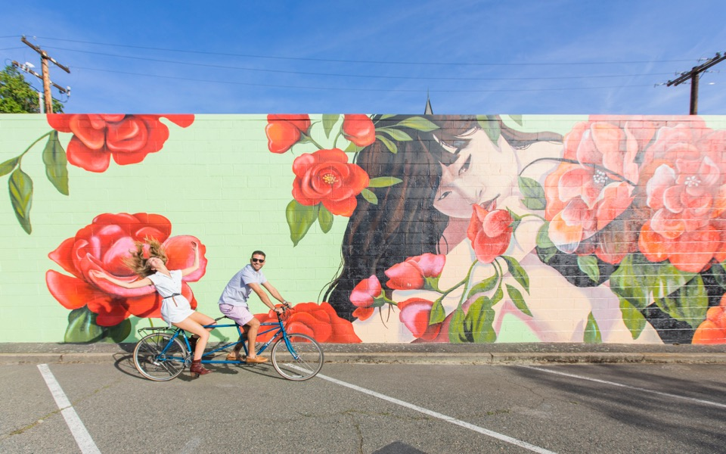
Roseville Rankings from Money Magazine
Top 50 Best Places to Live in America 2020
Top 10 Best Places to Retire in America 2020

Slide 5
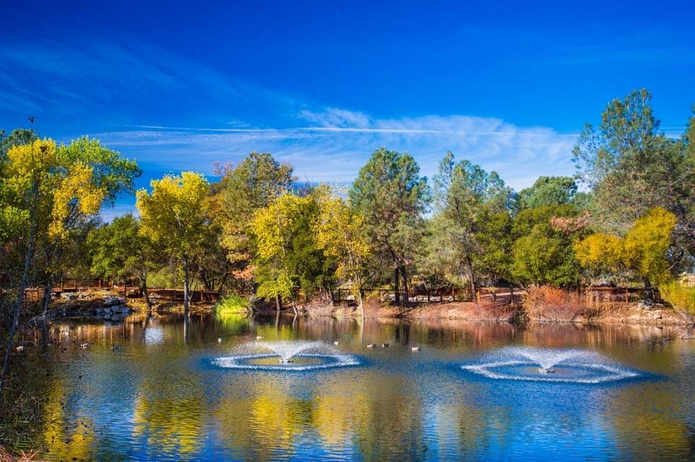
Rocklin Rankings from Money Magazine
Top 50 Best Places to Live in America 2021

Slide 6
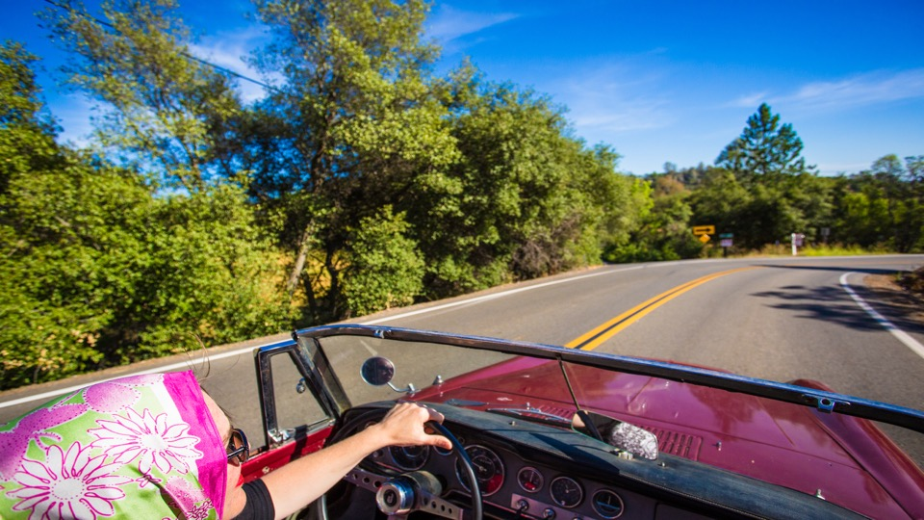
Quality infrastructure facilitates easy access to the county’s bountiful assets from South Placer all the way to North Lake Tahoe.
Ongoing investment in our highway system will be crucial to long-term lifestyle sustainability.

Slide 7
Opportunity: Make Permanent the Experiential
Changes Made During the Pandemic

Slide 8
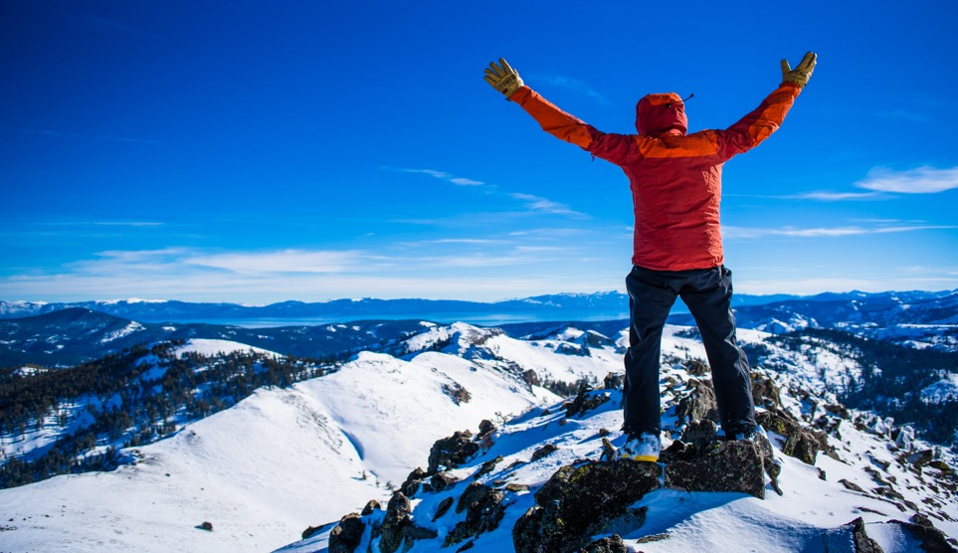
“A single glimpse of heaven is enough to confirm it’s existence, even if it’s never experienced again.”
--Abraham Maslow

Slide 9
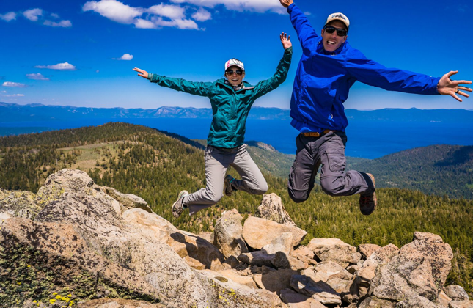
THANK YOU!
Rob Haswell, CEO, Visit Placer

