Slide 1
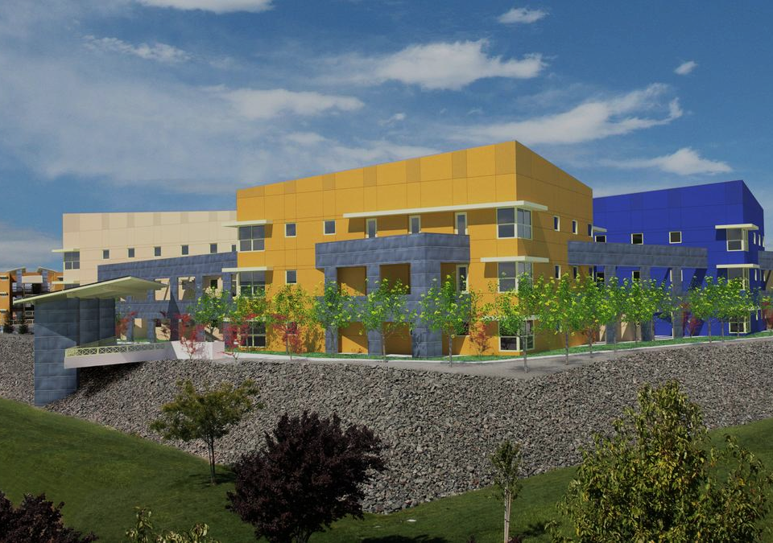
(Begin at 3:45) https://vimeo.com/westfallgold/review/525194200/15ea4b1e4e
Notes:
Wju password
2:50-3:30

Slide 2




Meeting Our
Workforce Needs
Phillip Escamilla
Vice President of Academic Affairs
William Jessup University

Slide 3
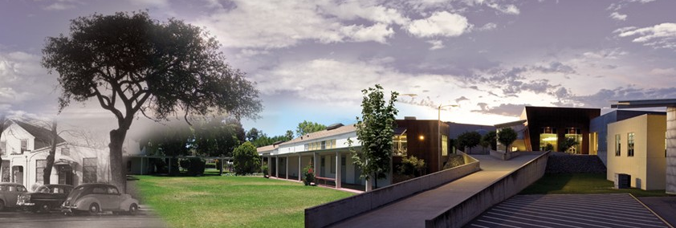
Jessup Profile
Over 1700 Students on two campuses
Online, adult degree completion, traditional undergraduate
60 associate, bachelor’s, and masters programs

Slide 4

US News & World Report Rankings
#3 in Regional Colleges West
#6 in Best Value Schools
#1 in Top Performers on Social Mobility

Slide 5
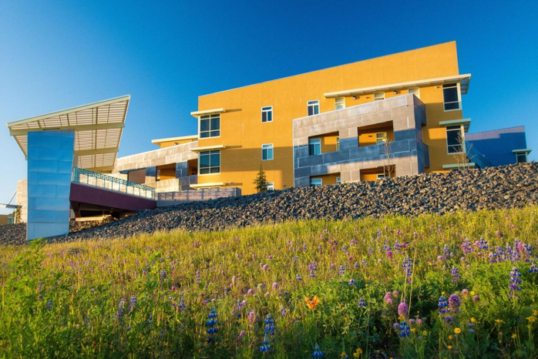
Workforce
Development Certificates
Currently Offered:
  Project Management
  Computer Science
  Executive Coaching
Under Development:
  Paralegal
  Cyber security
  Web Development
  Accounting

Slide 6

Health Care-Related
Programs and Certificates
Programs
  BS in Nursing to launch in Fall 2022
  Mobile Health Clinic
Certificates
  Health Care Administration
  Gerontology
  Phlebotomy
  Home Health Aide

Slide 7
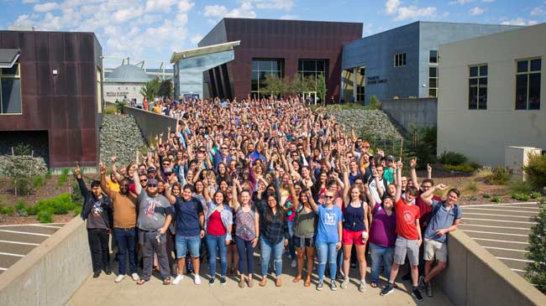
Jessup Distinctives
Aviation Degree
Institute for Biodiversity and the Environment
Institute for Public Policy

Slide 8
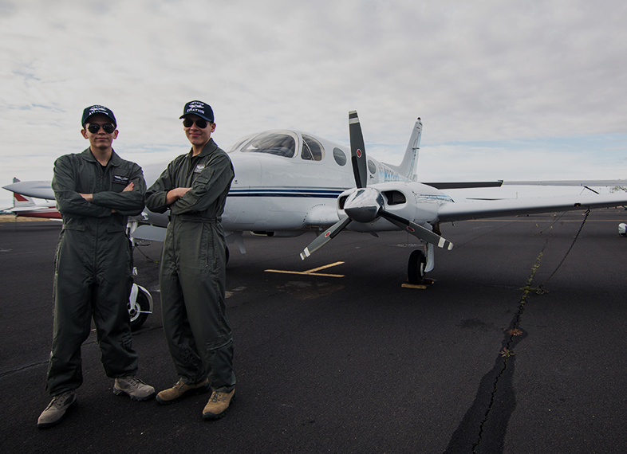
Aviation
Part 141 Pilot School Authorized
Two Flight Simulators on Campus

Slide 9
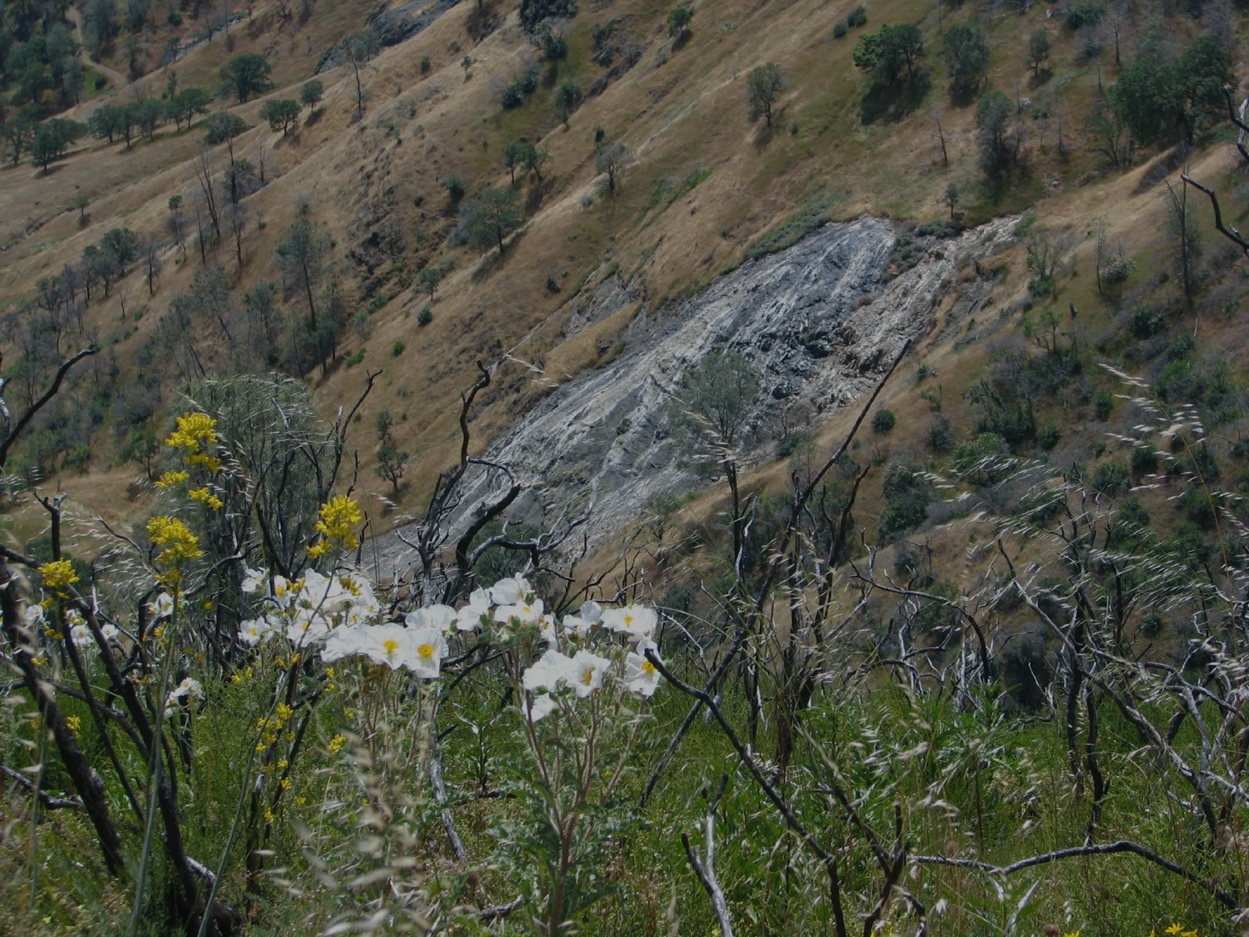

Institute for Biodiversity
and the Environment
Environmental Chemistry and Landfill Research
  Building collaboration to engage faculty and students in paid environmental chemistry research opportunities at the landfill.
  Engaging students in ongoing research at the landfill in collaboration with the Western Placer
Waste Management Authority.
Pacific Crest Trail Biodiversity
Megatransect
  Received a $5,000 grant from
the National Park Service.

Slide 10
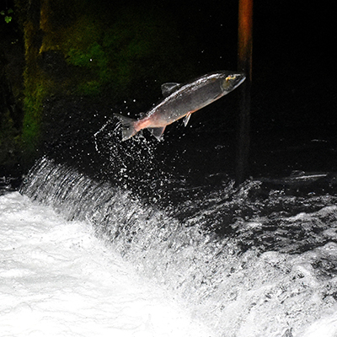
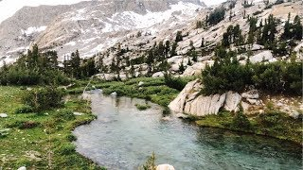
Institute for Biodiversity
and the Environment
Chinook salmon and Steelhead Study in Western Placer County
In support of the Placer County Conservation Program.
Completed pilot eDNA Study on the distribution of Chinook Salmon in Raccoon Creek, Doty Creek, and Auburn Ravine.

Slide 11
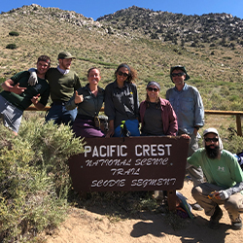
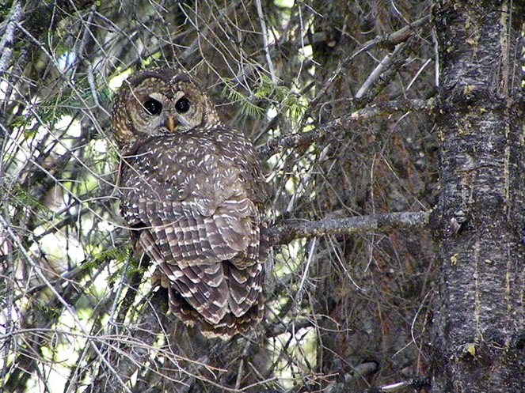
Institute for
Biodiversity and
the Environment
Burrowing Owl Restoration Project at Swainson's Preserve
Received $15,000 from the Sierra Foothill Audubon Society to build artificial burrows and to monitor the sites for owl activity.
Collaboration with the Placer Land Trust, who manages the preserve.

Slide 12

Institute for Public Policy
Creating public/private partnerships to develop job training for the homeless.
Research training/education programs that provide hard and soft skills needed by employers to be competitive in our global marketplace.
  Ex: anti-poverty and job training programs in California
An analysis of public/private education/employment support programs for foster youth that are aging out of the system.
Other areas of emphasis: education, public safety, mental health.

Slide 13
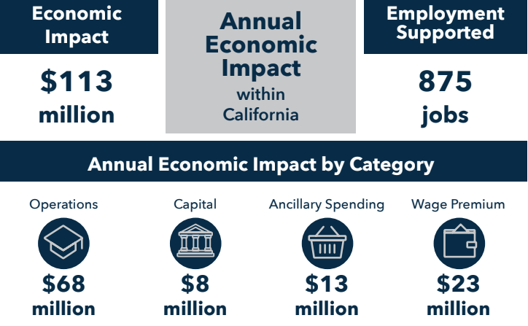
Economic Impact
Each year, Jessup’s activity generates an economic impact of $113 million within California and supports 875 jobs.
Jessup’s economic activity generates $4.6 million per in tax revenue for CA

Slide 14
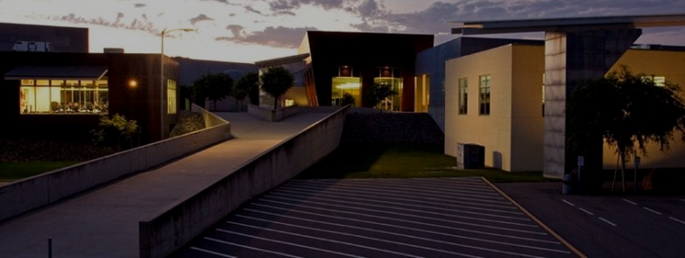
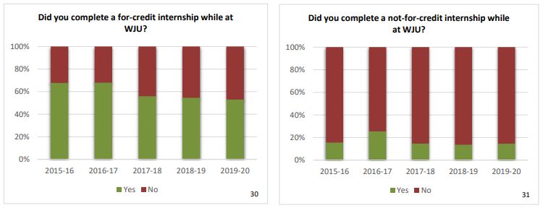
Employment:
Current Students

Slide 15
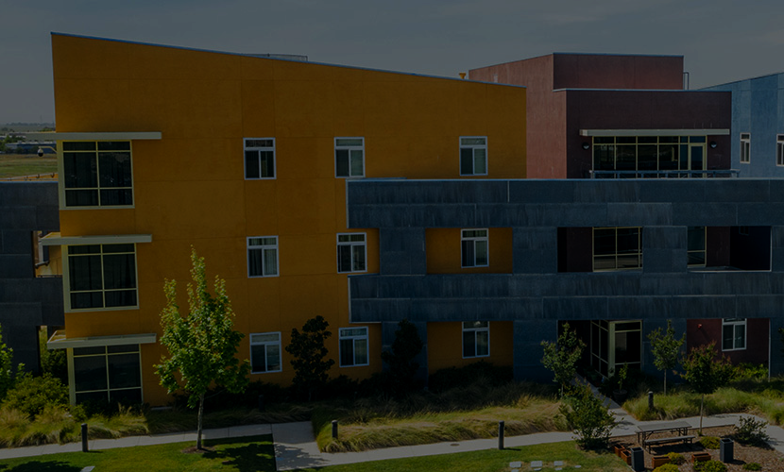
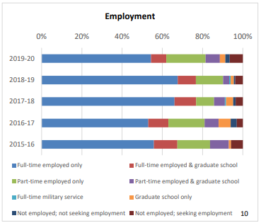
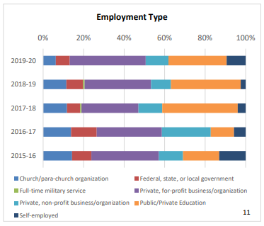
Employment:
Graduates

