Slide 1
Community Reinvestment
Coalition
October 2021

Slide 2
Coalition of five community bank GSEC investors collaborating to maximize impact of lending, investments and other efforts in low- to moderate-income areas of the Greater Sacramento region
Current members:
Chair, Jeremiah Smith, First Northern Bank
James Beckwith, Five Star Bank
Steve Fleming, River City Bank
Ciaran McMullan, Suncrest Bank
Michael Olague, Bank of the Sierra
Based on Community Reinvestment Act best practices research conducted by GSEC
First initiative: deploy $100 million in financing to support affordable housing development in the Greater Sacramento region

Slide 3
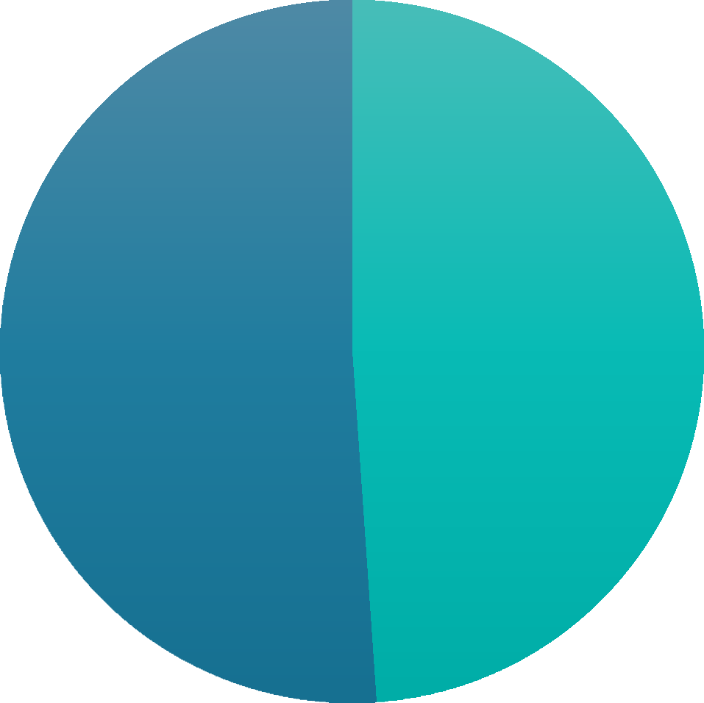
The CRC is helping to address the regional affordable housing need
Housing units needed
According to SACOG’s Regional Housing Needs Plan, Placer County needs 31,440 housing units from 2021 to 2029
9,591 very low- income units
Moderate- or above- moderate income households
51.1%
Very low- or low- income households 48.9%
5,781 low- income units

Slide 4
We share assets to achieve a common vision for economic prosperity
The region depends on Placer County for economic opportunity:
Home to William Jessup University and Sierra College
Home to major high-technology employers (e.g., Oracle, HP)
Home building to accommodate talent growth, executive housing options
Quality of life with great schools and natural amenities
Placer County depends on the region for economic opportunity:
Connection to R1 research university (UC Davis)
Access to an international airport (SMF)
63% of Placer County residents are employed outside of Placer County

Slide 5
Thank you!
GreaterSacramento.com
@SelectSac
@GreaterSac
@SelectSacramento

