Slide 1
Living Better in Placer
Placer Business Alliance, Washington DC Wednesday, October 20, 2021
Debra Oto-Kent, MPH Founder, Executive Director

Slide 2
What I will discuss
Thriving Springboard for health framework
County health rankings: where does Placer County stand?
About HEC
Invest Health City, Roseville
Opportunities: the importance of multisector partnership

Slide 3
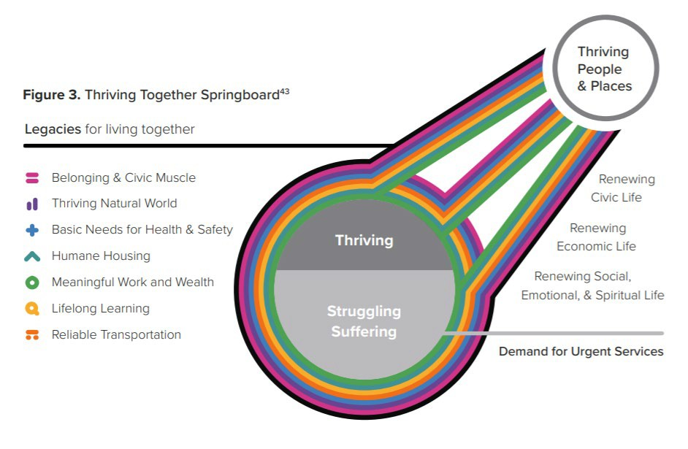
Healthy Neighborhood Investments – A Policy Scan & Strategy Map, February 2021

Slide 4
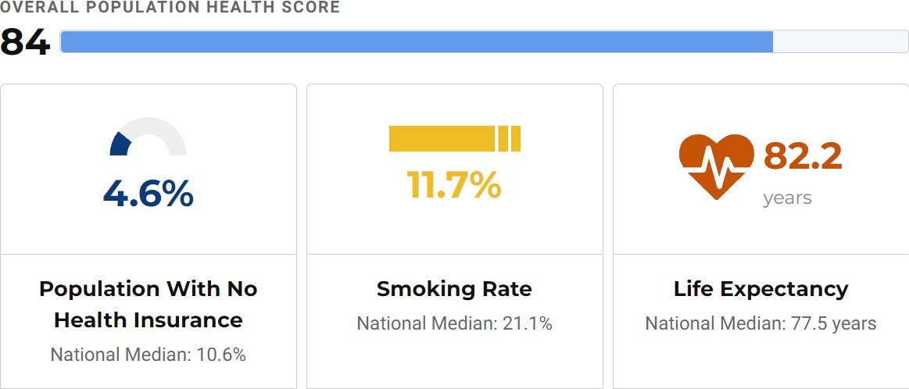
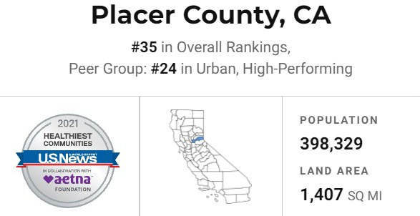
usnews.com/news/healthiest-communities/rankings

Slide 5
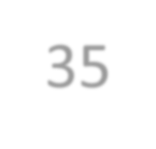
10 Categories that DRIVE COMMUNITY HEALTH on a scale of Zero to 100
2021 rankings of
the top 500
Healthiest Communities nationwide
35
Placer County, California
www.usnews.com/news/healthiest-communities/rankings

Slide 6
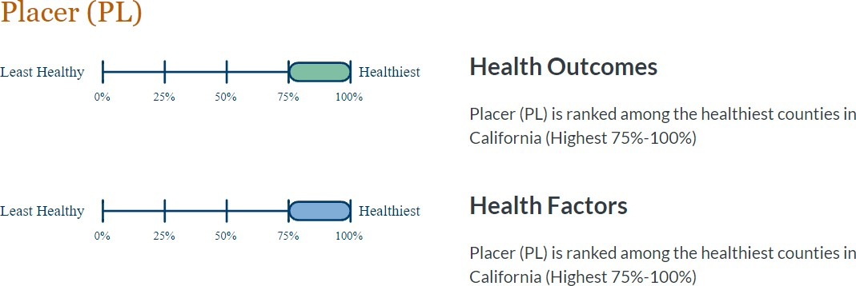
County Health Rankings & Roadmaps, a program of the University of Wisconsin, Population Health Institute 2021

Slide 7
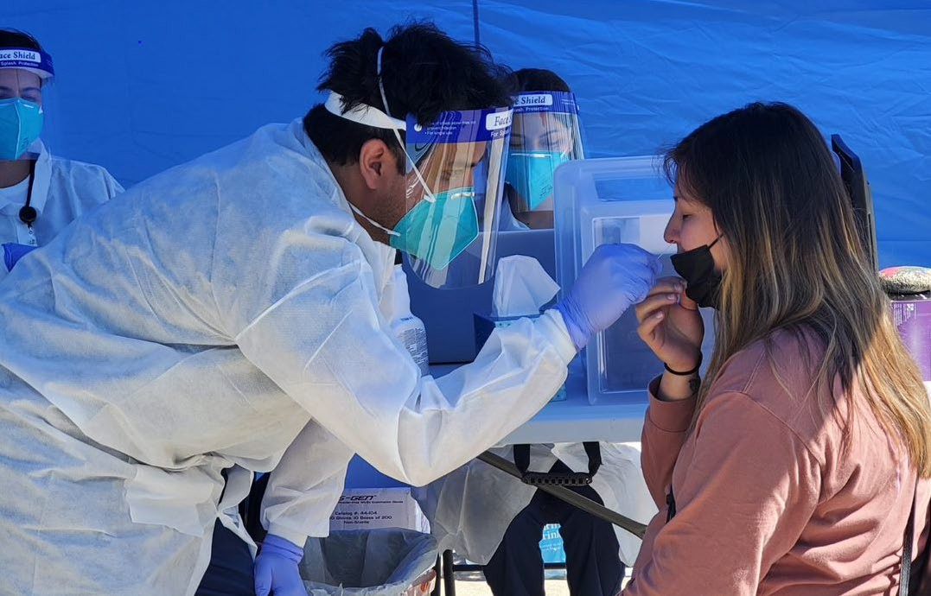
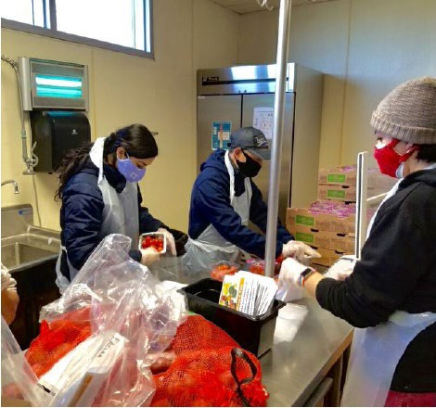
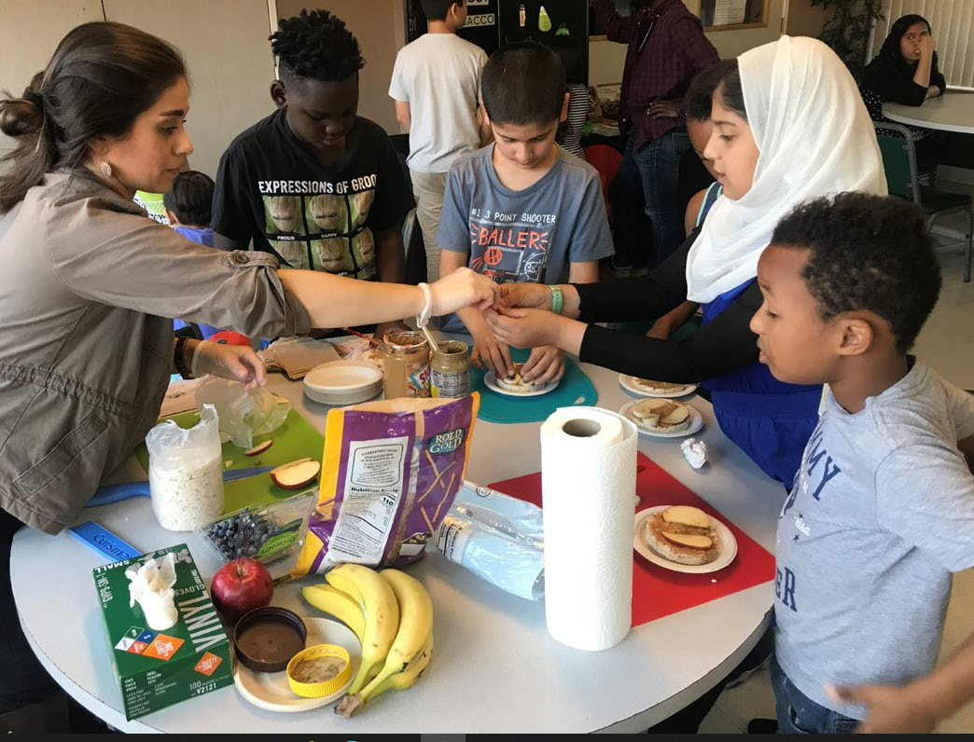
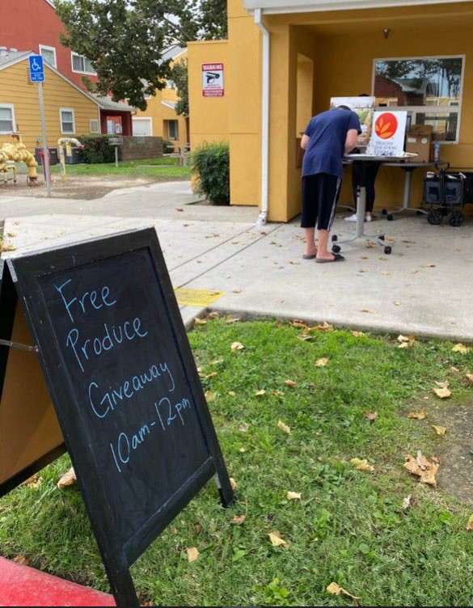
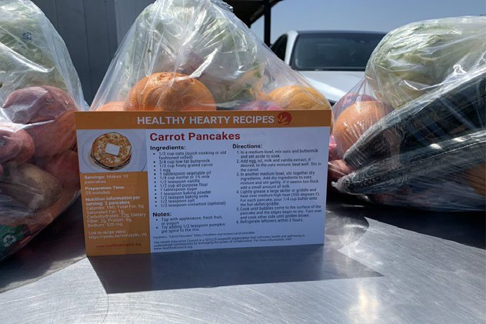
The mission of the Health Education Council is to cultivate health and well-being in under-served communities by leveraging the power of collaboration.

Slide 8
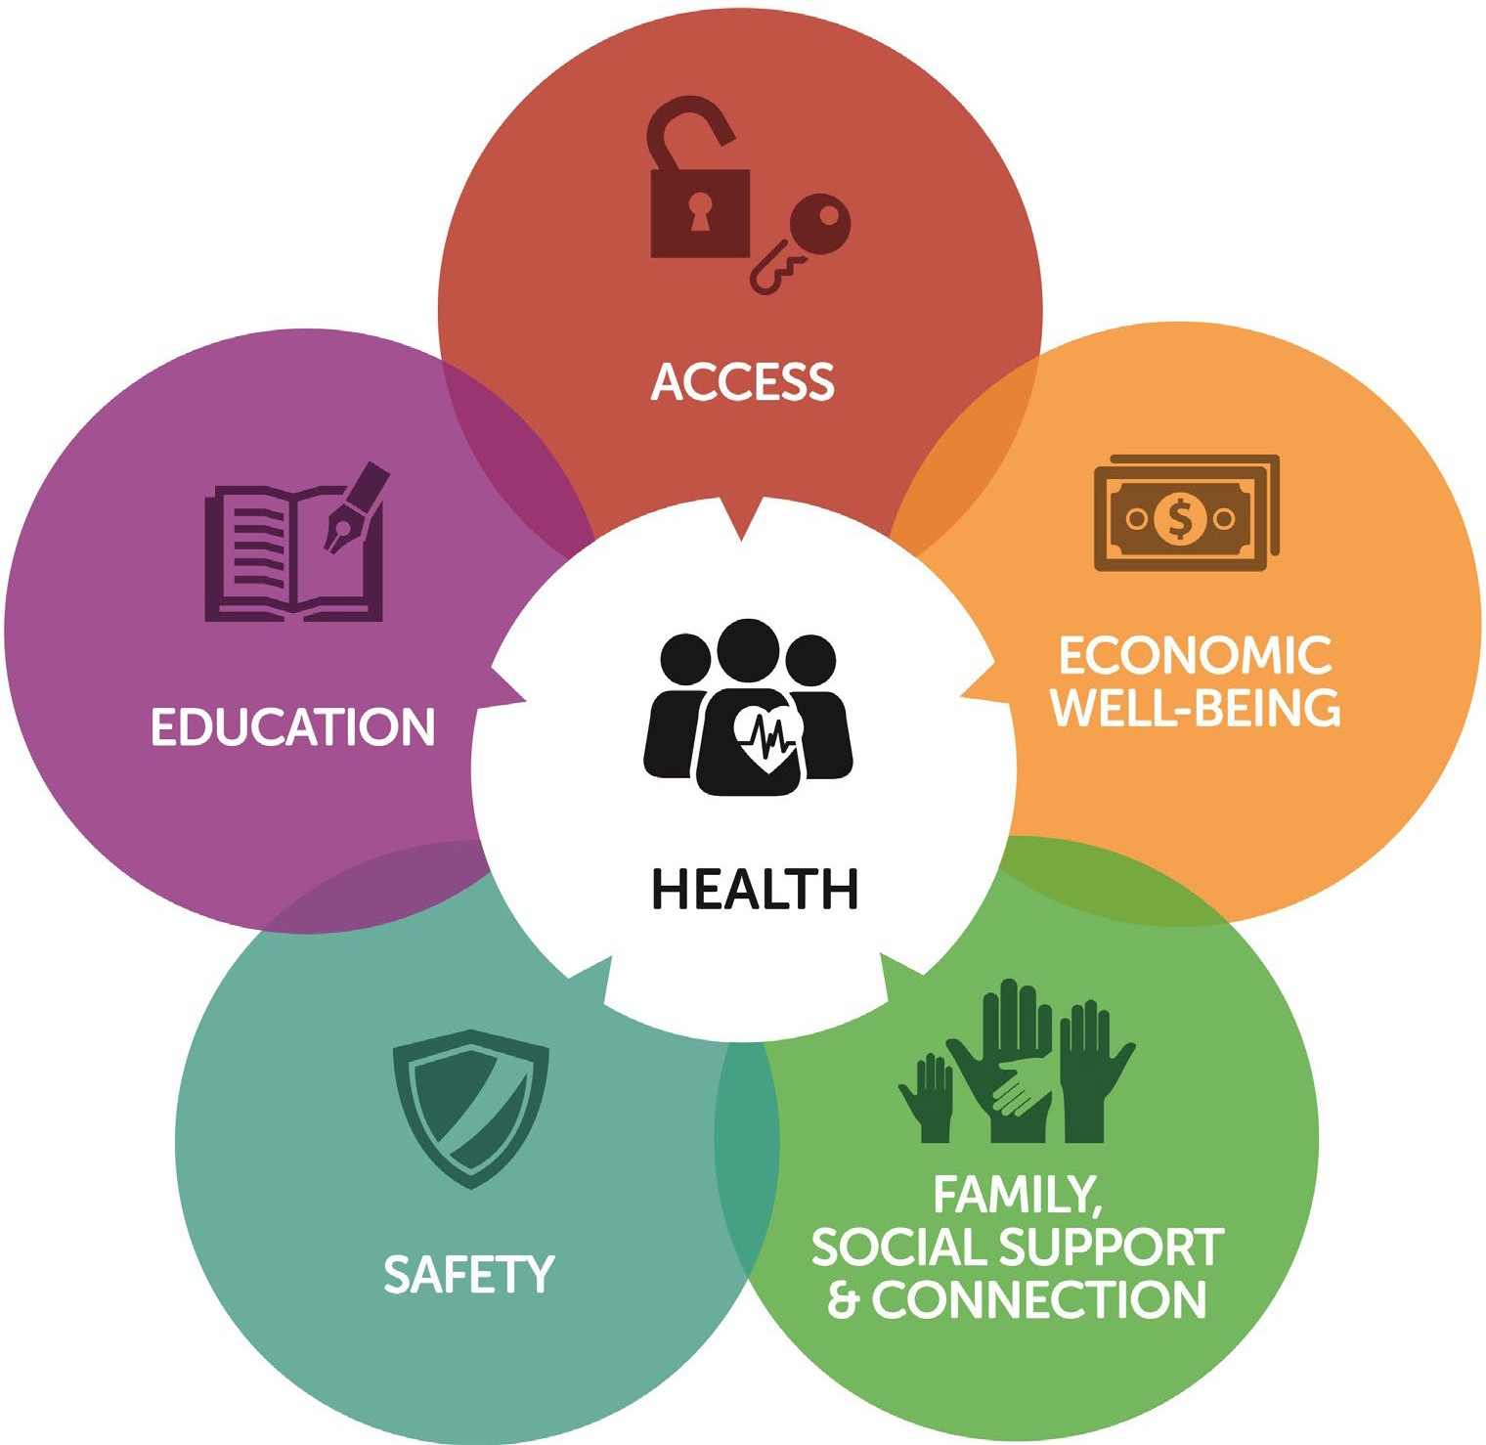
Key strategies of all HEC Initiatives:
Cross-sector collaboration/collective impact
Resident Engagement – asset based; historically, excluded

Slide 15
“Our best hope for escaping the adversity spiral and changing course is to organize local and nationwide action around a single unifying and measurable expectation: All people and places thriving- no exceptions.”
Healthy Neighborhood Investments – A Policy Scan & Strategy Map, February 2021

Slide 16
Debra Oto-Kent, MPH Founder and Executive Director dotokent@healthedcouncil.org
WWW.HEALTHEDCOUNCIL.ORG

