Slide 1
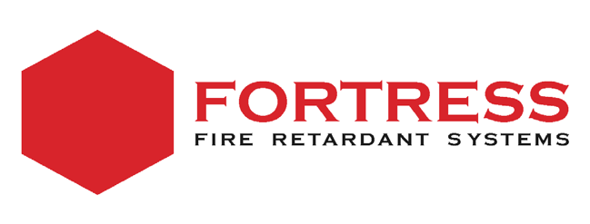
Fortress Fire Retardant Systems LLC City of Rocklin
Placer County, California
Presented by:
Robert Burnham, CEO Fortress North America

Slide 2
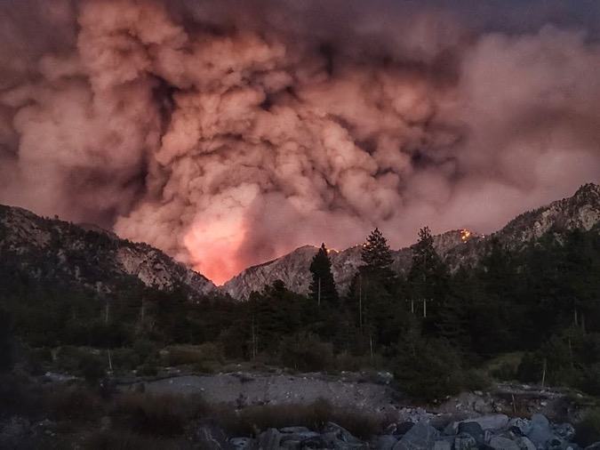
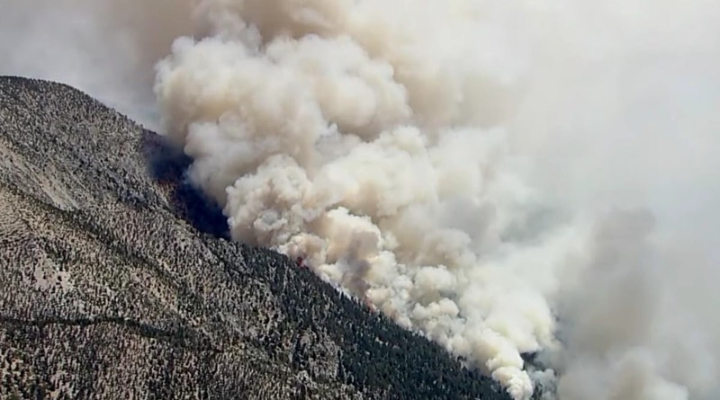
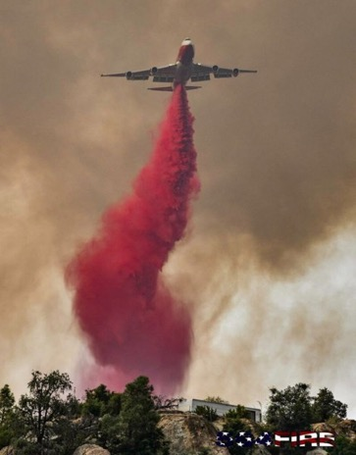
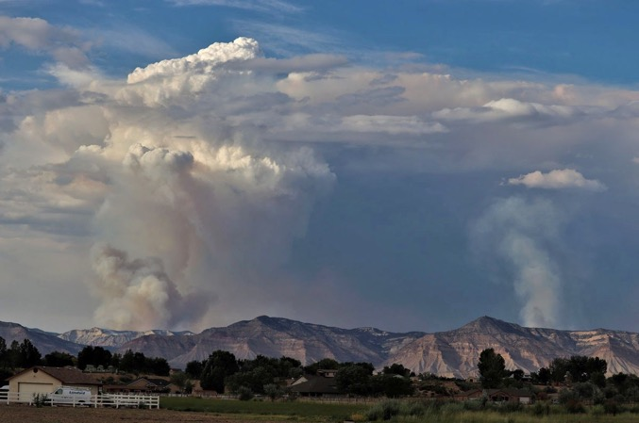
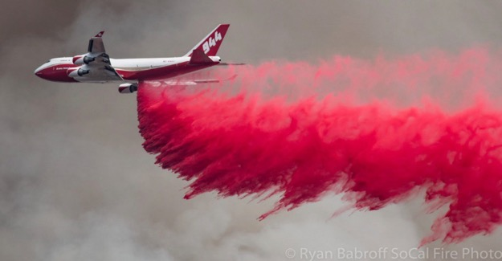
Fire Season 2021…..

Slide 3
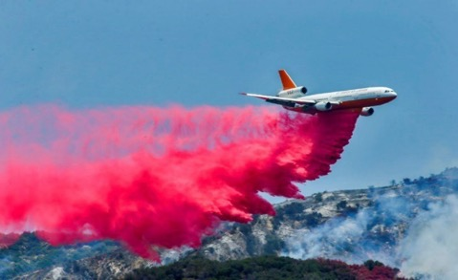
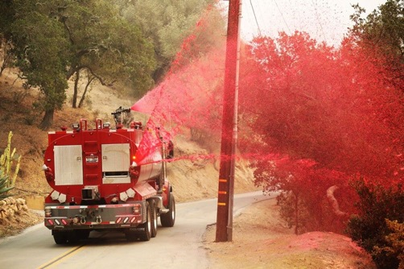
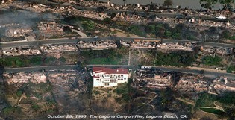
Fortress Fire Retardant Product Family
FR-100 FR-200
Aerial Fire Retardant….
It is primarily used for airtankers and helicopter.
Long-Term, High-visibility red (fugitive)
color.
Largest use of fire retardants…
FR-600
Ground Applied Fire Retardant Specifically designed for Utility, Industrial and ROW applications.
Ultra-durable LTR; Colored or clear
Structural Fire Retardant
Residential & Commercial Pre-Treatment Fire Retardant for Structural Application – LTR colorless…
FR-700

Slide 4
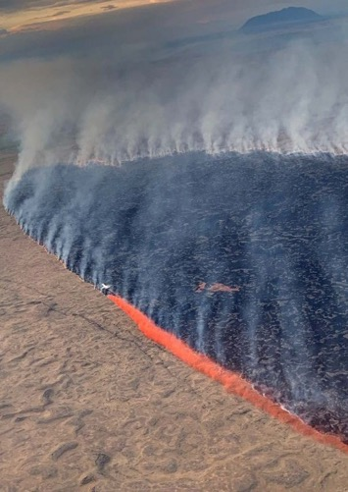
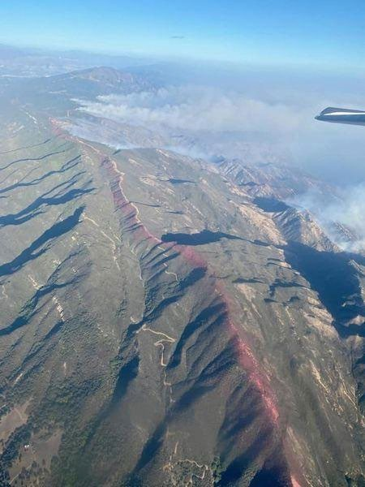
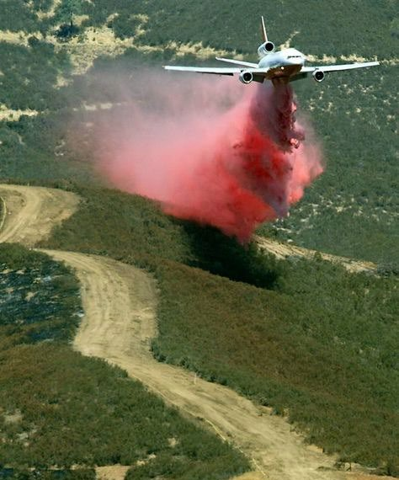
Long-Term Fire Retardant
LTRs contain inorganic salts mixed with water that retards the way the fire burns:
85% water, 10%-15% MgCl,
Decreases the fire / flame intensity & slows the advance of the fire….. effective even after the initial water has evaporated.
LTRs are effective in direct, indirect and pre-treatment fire attack

Slide 5
The Business Side of Forest Health, Natural Resource Protection and Community Fire Preparedness & Defense……
Presented by:
Robert Burnham, CEO Fortress North America

Slide 6
SAM.gov
Understand the Federal market opportunities &
Do your research…..
Manage your expectations…

Slide 7
Fire Retardant : Federal Use Trends….
Figure 3: Retardant Total₅s_{7.}b₃ y year 2011-2020
56.0
55.0
48.7
45.0
42.3
In Millions of Gallons
35.0
28.6
29.5
27.1
25.0
23.6
20.5
19.7
15.0
5.0
2011 2012 2013 2014 2015 2016 2017 2018 2019 2020

Slide 8
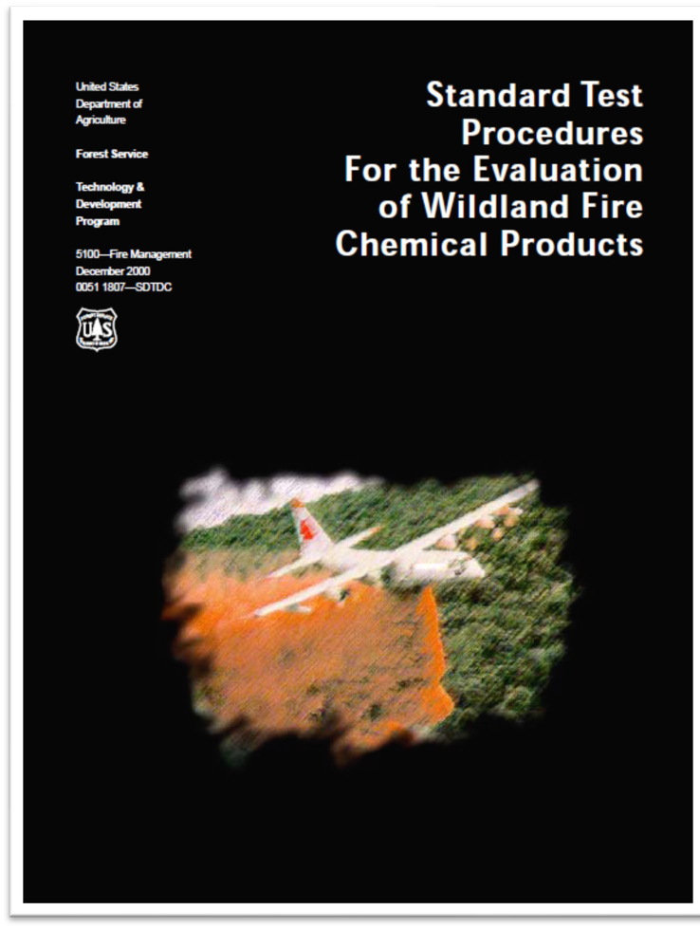
Federal Product Qualification & Market Challenges/Barriers …
In the last decade, only Four Companies Applied For The US Forest Service Long Term Aerial Fire Retardant Qualified Products List (QPL)
23 LTR Submission Failures (All)
Since 1999, only Perimeter Solution’s Phos- Chek were approved products on the USFS QPL (i.e. MONOPOLY)
Market entry strategy: Build a superior, innovative, NextGen fire retardant product
You pay for your own Federal lab testing…
After three+ years & $7MM investment….
2021, Fortress now has three products on the FS QPL, one fully qualified
Targeting a FS National contract in 2022/23

Slide 9
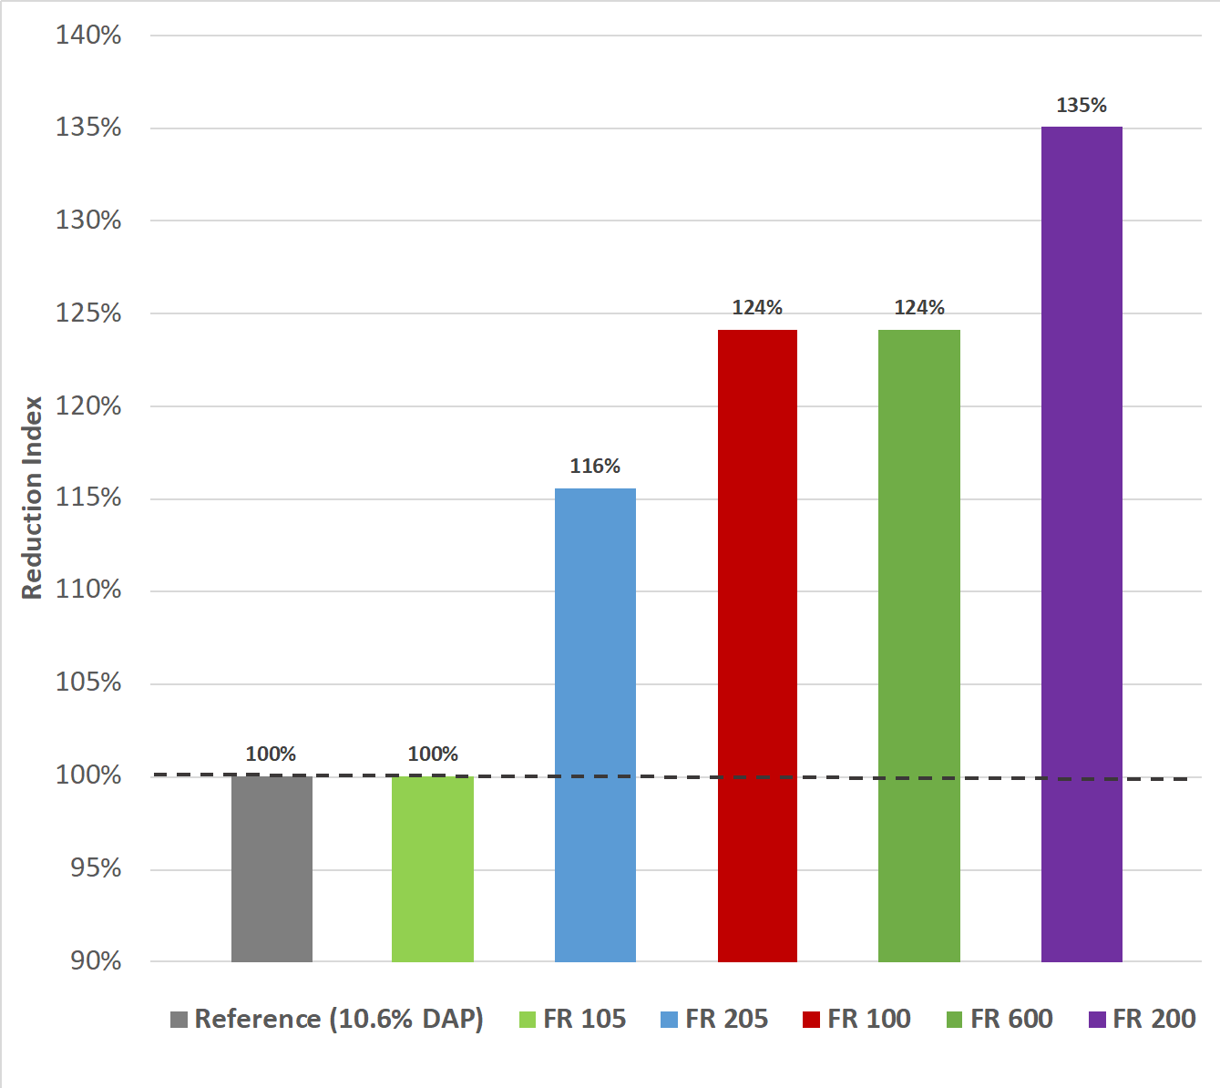
U.S. Forest Service Retardant Burn Test
US Forest Service QPL testing showed that Fortress fire retardants are up to 30% more effective in fire retarding than the 10.6% DAP control – reduces the incidence of “ burn-thru”
CONFIDENTIAL

Slide 10
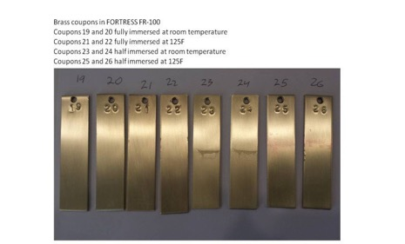
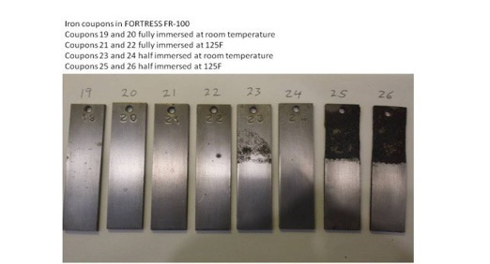
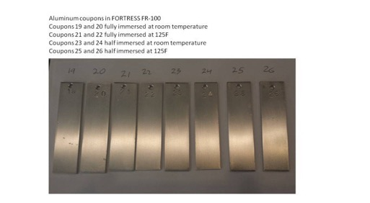
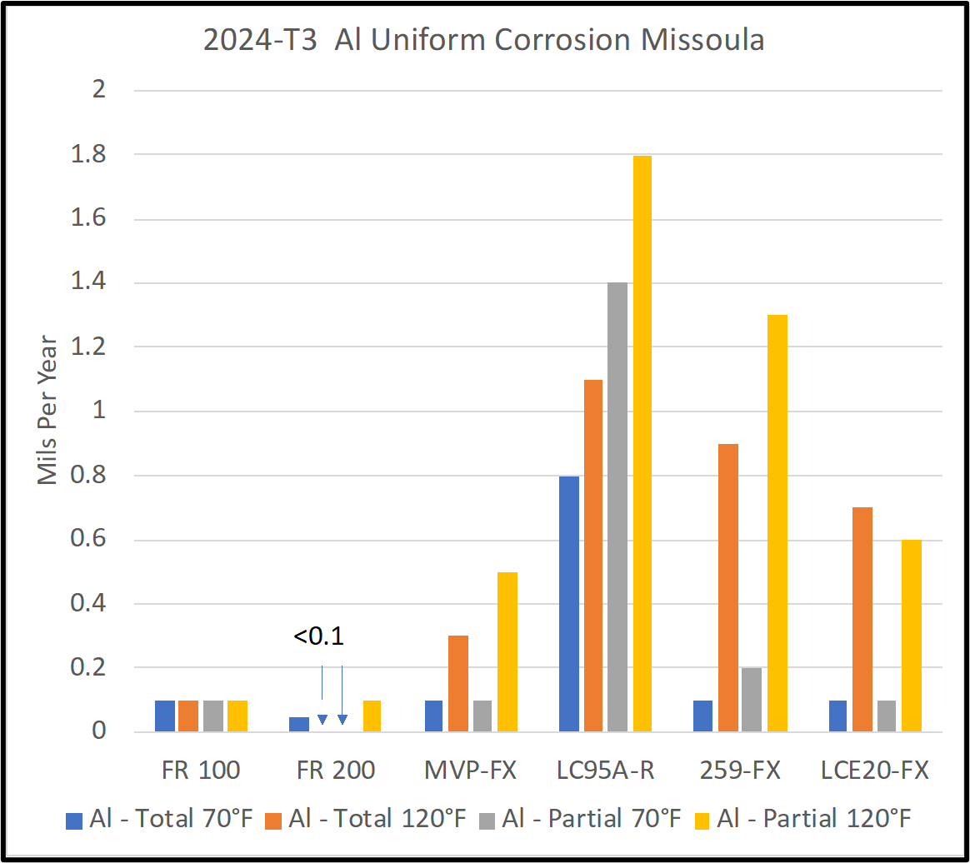
US Forest Service Corrosion Test Results FORTRES Fire Retardants – Best-in-Class corrosion test.
Fortress BrassCoupons Fortress Iron Coupons Fortress Aluminum Coupons
Airtanker 101
Why anti-corrosion is required on aircraft

Slide 11
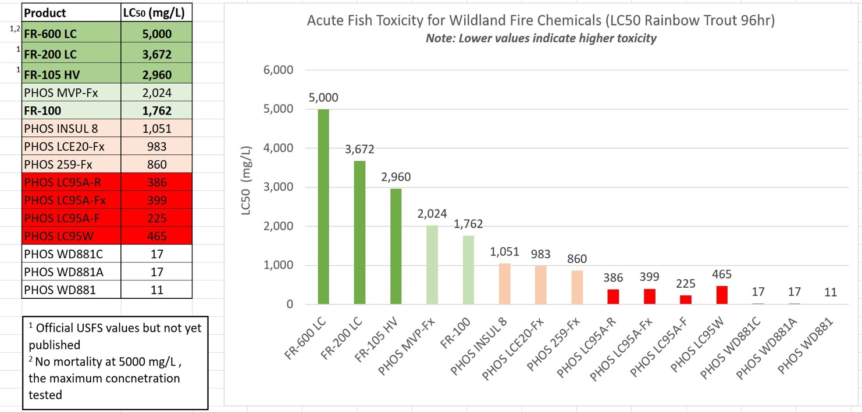
Fortress Fire Retardants: BEST-IN-CLASS AQUATIC TOXICITY RATINGS: US Forest Service LTR Test Results….
Fortress manufacturing has an almost ZERO CARBON FOOTPRINT & Sourced in the USA

Slide 12
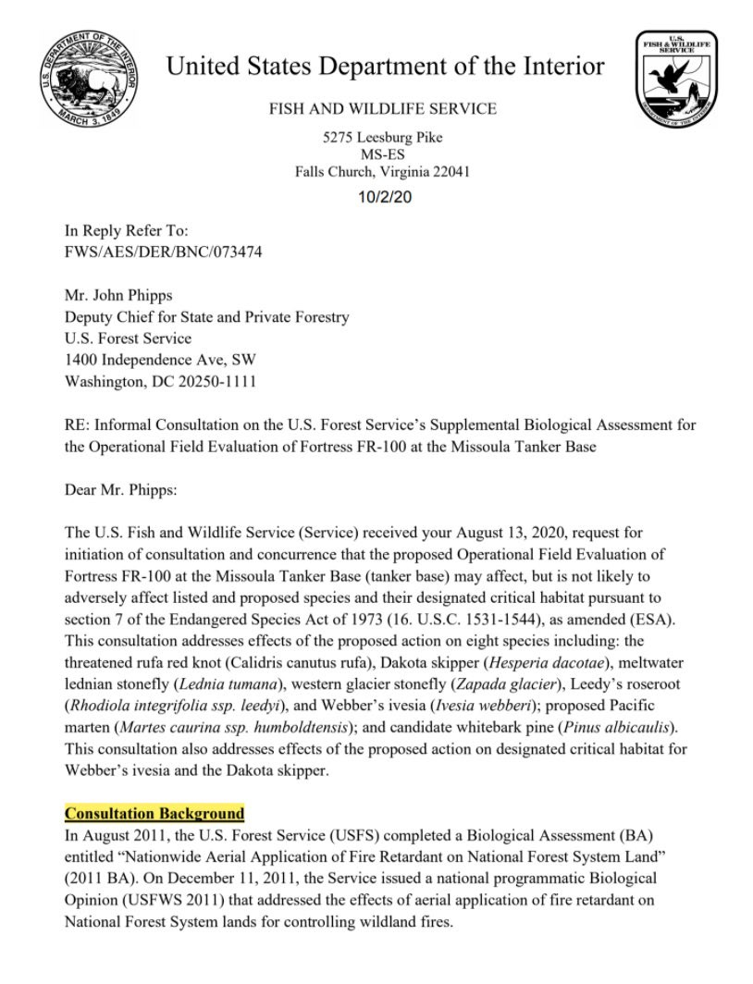
FWS Supplemental Bio Assessment for FR-100
“As part of the reinitiation package with the 2020 OFE BA, the USFS provided a risk assessment to the Service analyzing the effects of the newest product, FR-100. The risk assessment demonstrates FR-100 has similar or lower toxicity for representative species to previously used retardant formulations. “

Slide 13
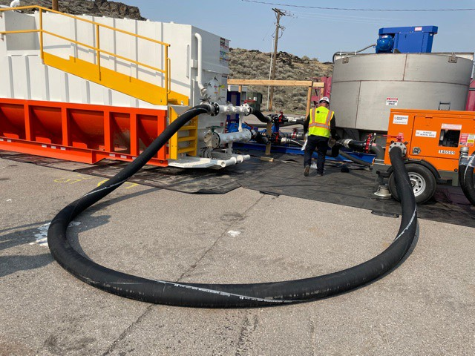
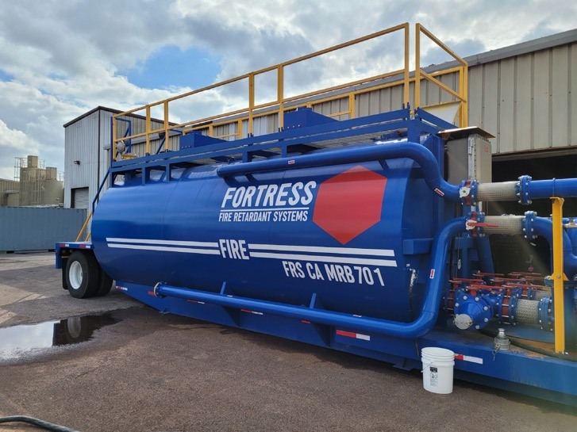
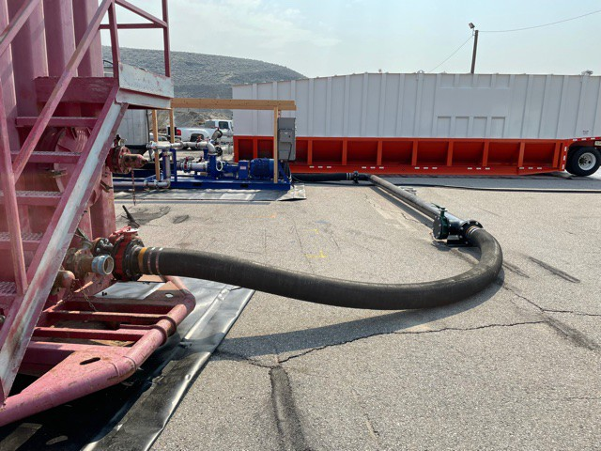
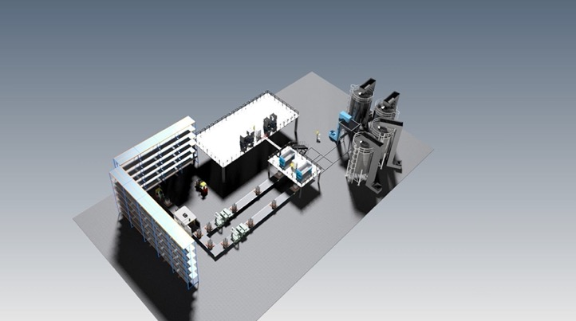
Fire retardant manufacturing plants at Ogden, UT, Rocklin, CA, & Merced CA

Slide 14
USForest Service
Washington Office
Fire & Aviation Management
Long-Term Retardant forWildland Fire Management
Qualified by US Forest Service in Accordance with Forest Service Specification 5100-304d
These products are evaluated, qualified, and approved for use only at the specified mix ratio withthe indicated applicationequipment.
Consult individual agencies for specific policies relating to long-termretardant use.
Definition Retardants containsalts that decrease fire intensity and slowadvanceof the fire, evenafter thewater they containevaporates.
Chemical | Mix Ratio | Qualified A[!Qlications¹
 | (Poundsconcentrateper gallonwater) | Fixed-Wing³ |  | Helicopter |  | Ground Applied
 |  | Multi Engine | SEATS | Fixed-Tank | Bucket
Dr11 Concentrate - Gum-thickened; Permanent or Temporary Base
Phos-Chek MVP-Fx | 0.96 lb/gal | • | • | - | • | •
Phos-Chek MVP-F | 0.95 lb/gal | • | • | - | • | •
Fortress FR-100 | 1.68 lb/gal | 0 | 0 | - | 0 | 0
Drv Concentrate - Gum-thickened; Temporary Base
Phos-Chek 259-Fx | 1.01 lb/gal | • | • | • | • | •
Wet Concentrate - Gum-thickened; Permanent or Temporarv Base
Phos-Chek LC-95A-R | 5.5:1 | • | • | - | • | •
Phos-Chek LC-95A-Fx | 5.5:1 | • | • | - | • | •
Phos-Chek LC-95A-F | 5.5:1 | • | • | - | • | •
Phos-Chek LCE20-Fx | 5.2:1 | • | • | - | • | •
FortressFR-200 | 24:1 | 0 | 0 | - | 0 | 0
Wet Concentrate - Gum-thickened; Temporary Base
Phos-Chek LC-95-W | 5.5:1 | • | • | - | • | •
Pretreatment, Non Storable²
Phos-Chek LC-95-W | 5.5:1 | - | . | . | - | •
Phos-Chek LC-95A-Fx | 5.5:1 | - | . | . | - | •
Phos-Chek Fortify | 4 | - | - | . | - | •
Phos-Chek LCE20W | 4 | - | - | . | - | •
fQrt s FR-60Q | 4 | - | - | . | - | •
Komodo | 4 | - | - | . | - | •
1 - QualificationNotes Fully Qualified- Product complieswithall requirementsof a formal specification. o Conditionally Qualified- Product complies withall requirementsin the specificationfor laboratoryevaluation;a field evaluationisrequiredfor lull qualification. I', InterimQualified - Product complies withall interimrequirementsinAppendix A of the specification, final results and a fieldevaluationisrequiredfor full qual1ficalion. - Not qualified forthis application - Pretreatment categoryhas not been evaluated for durability and weathering. - CAUTION: When switchingbetween products fromdifferent manufacturers, rinsing thetank is required. Cross-mixing of theseproducts may increasemaintenancetimeand cleaning. - Theseproducts are designed tobe deliveredpre-mixed andready-to-useas pretreatment chemicals.Nomixingshall take placeafterpurchase.

Slide 15
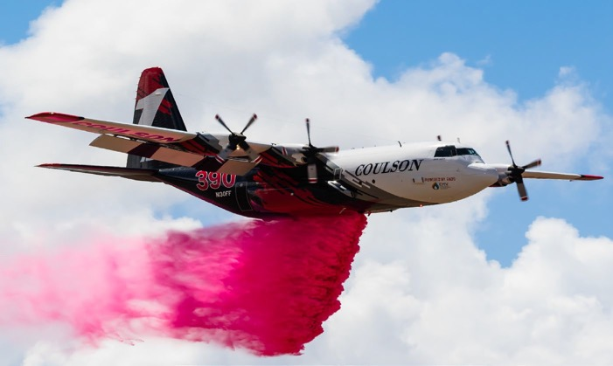
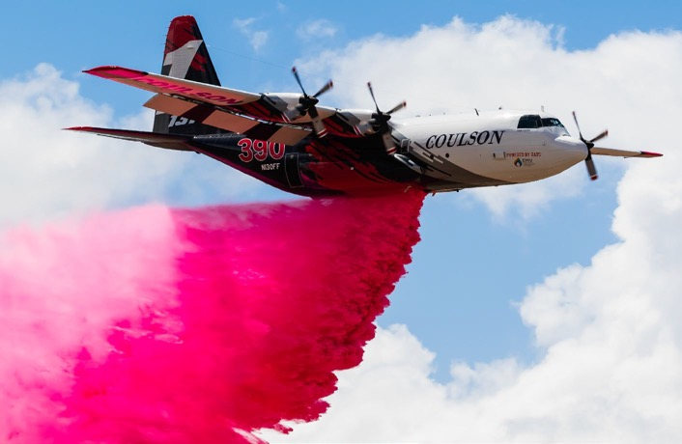
Victoria State, Australia
2021 Fortress Fire Retardant Test

Slide 16
The Business Side of Forest Health, Natural Resource Protection and Community Fire Preparedness & Defense…… Look at other than Federal markets for additional success
Presented by:
Robert Burnham, CEO Fortress North America

Slide 17
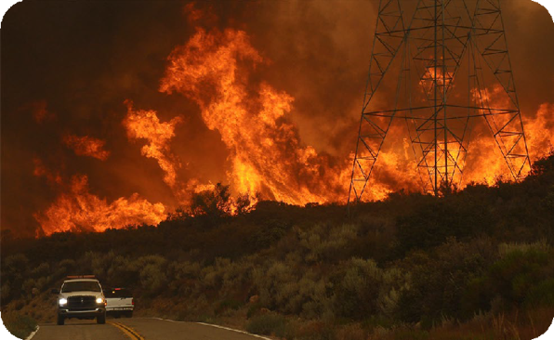
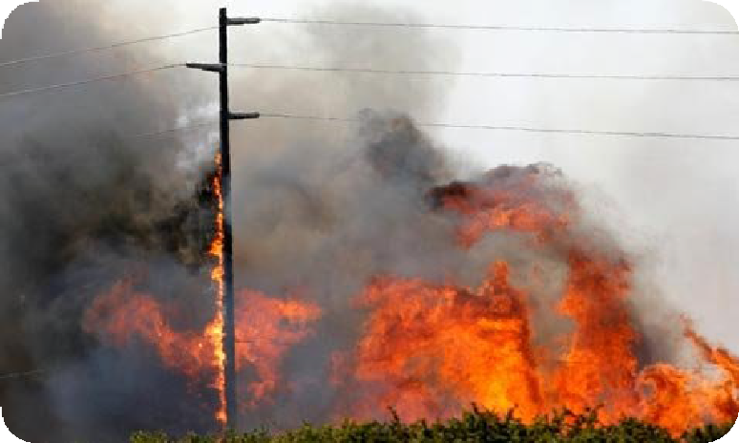
IMPLICATIONS OF UNHEALTHY FORESTS and LONGER FIRE SEASONS…
“FIRE SEASONS”; Fire Environment

Slide 18
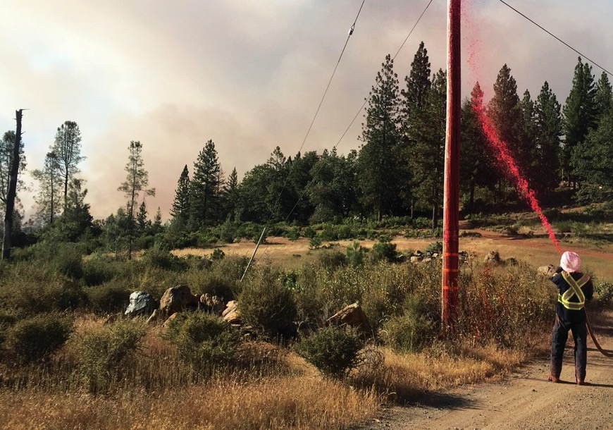
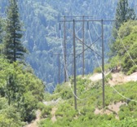
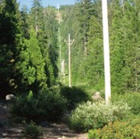
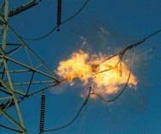
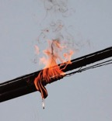
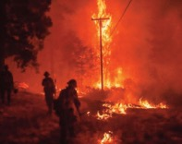
Pretreatment
Fire Retardants for Utility Right-of-Ways
®
FORTRESS® Long-Term Fire Retardants
Fortress® Fire Retardants represent a technologically advanced alternative to the current conventional ammonia-based fire retardants. Fortress® FR-100, has recently passed all US Forest Service laboratory tests for environmental toxicity, corrosion inhibition, and fire-retardant effectiveness.
The Fortress® long-term pretreatment retardants
include two new wildland fire formulations (FR-100 and FR-600) that have been developed for pretreat-
ment of high hazard and fire prone wildland firefuels. Fortress®retardants are not fertilizers; they do not contain ammonia or phosphate, which promote fire-prone invasive plant species, and are highly toxic
to native fish and aquatic ecosystems.
Fortress® fire retardants are highly effective at preventing vegetation ignitions related to overhead electrical lines, reducing a fire’s intensity, and stopping its spread.

Slide 19
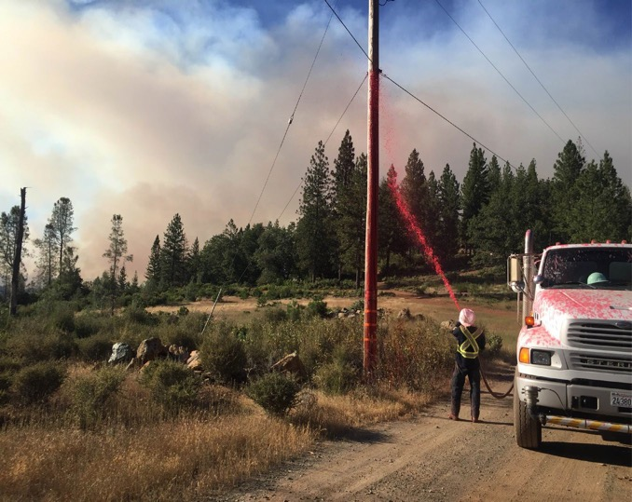
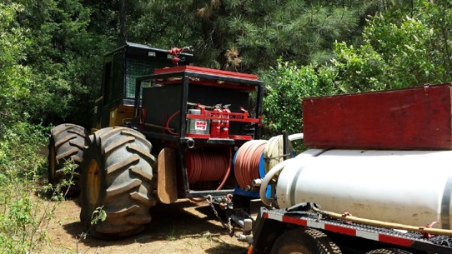
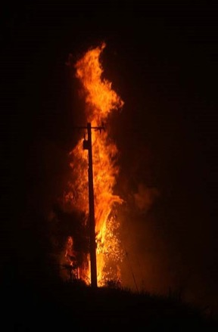
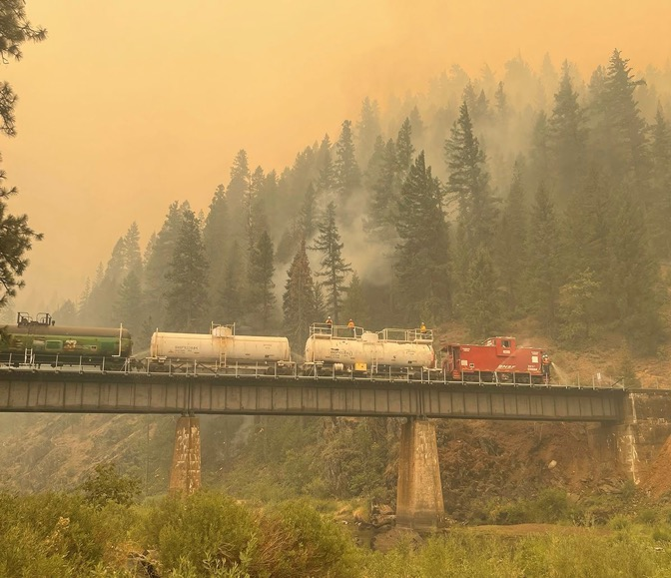
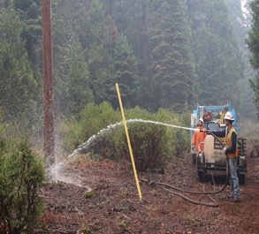
Fortress Ground-Applied Retardant
FR-600 Ground Applied Fire Retardant Specifically designed for Utility, Industrial and Railroad Right-of-Way applications.
Ultra-durable LTR; Colored or clear
PG&E, Railroads, Highways, Forest Health, Industrial Liability Insurance Reduction

Slide 20
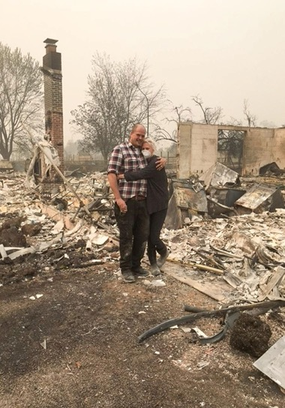
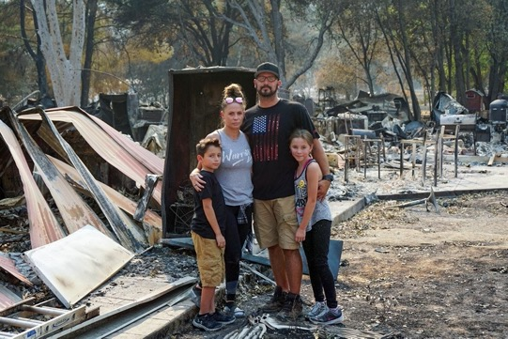
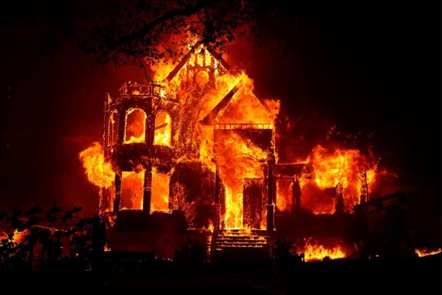
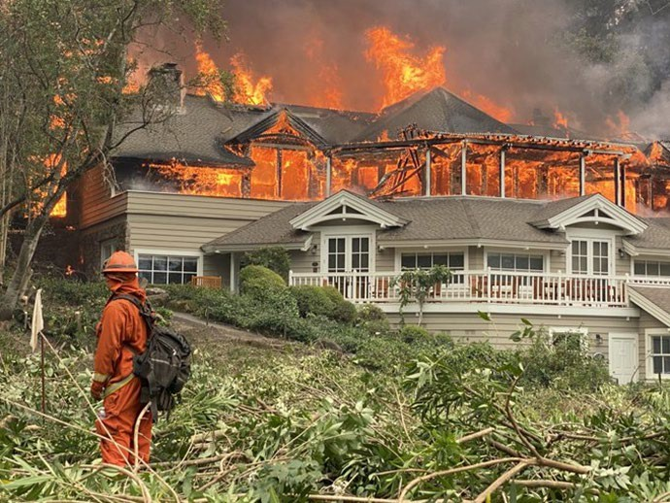
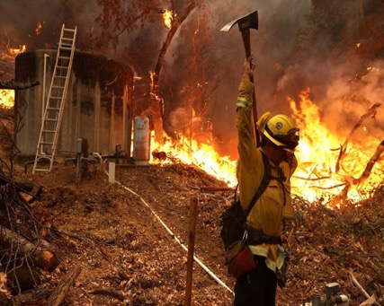
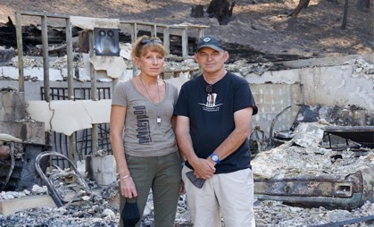
Lives changed forever…

Slide 21
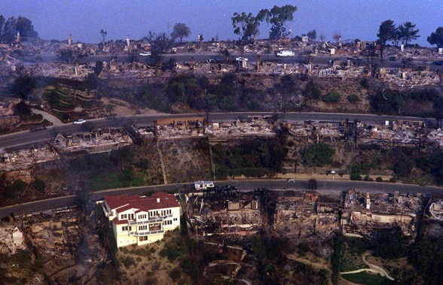
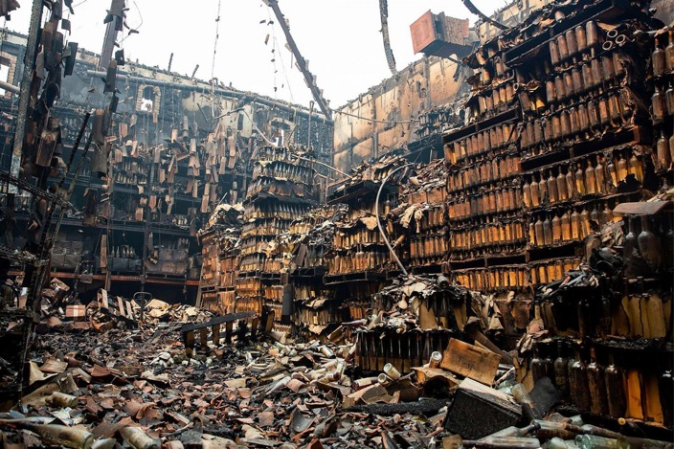
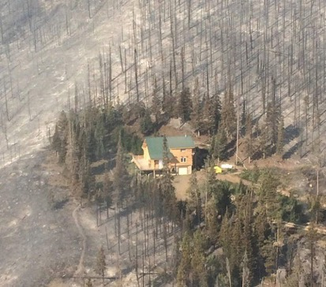
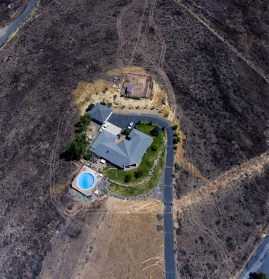
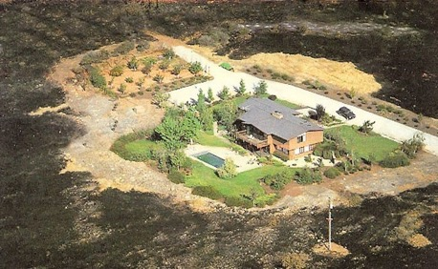
Fortress Structural Fire Retardant
FR-700 Structural Fire Retardant
Residential & Commercial Pre-Treatment Fire Retardant for Structural Application – LTR colorless…
CA Insurance Carriers…HOAs, Private Residences, Commercial Buildings, Napa Valley Wineries, etc.

Slide 22
Questions?

