Slide 1
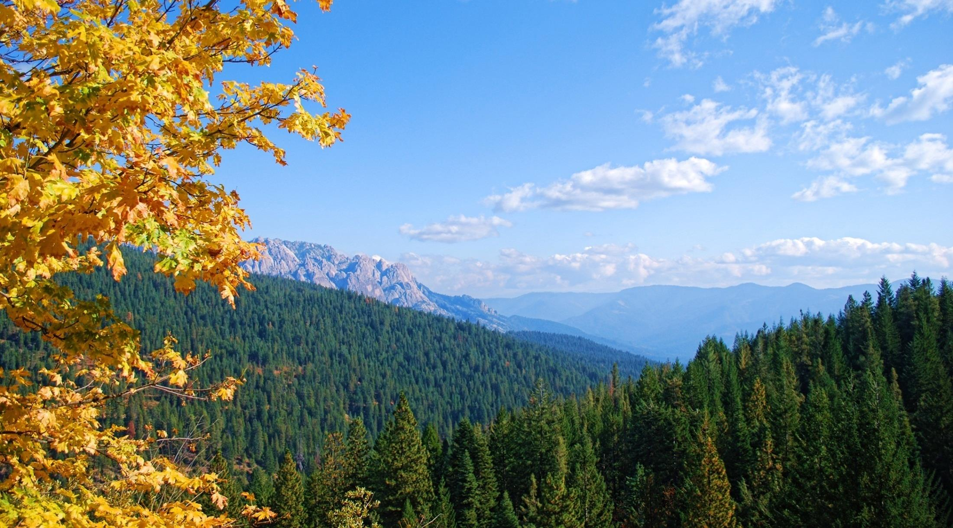

Wildfire resiliency in California
Placer County Business Alliance
Castle Crags, Sierra Pacific Industries Redding District Timberland in foreground

Slide 2
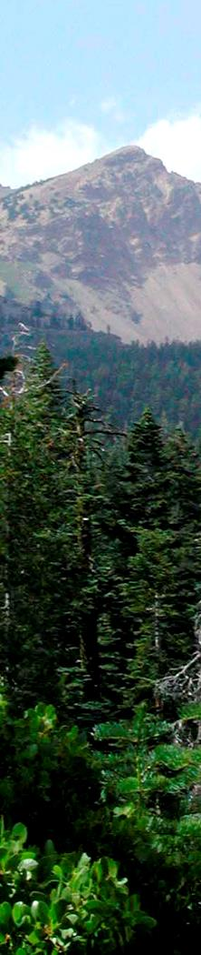
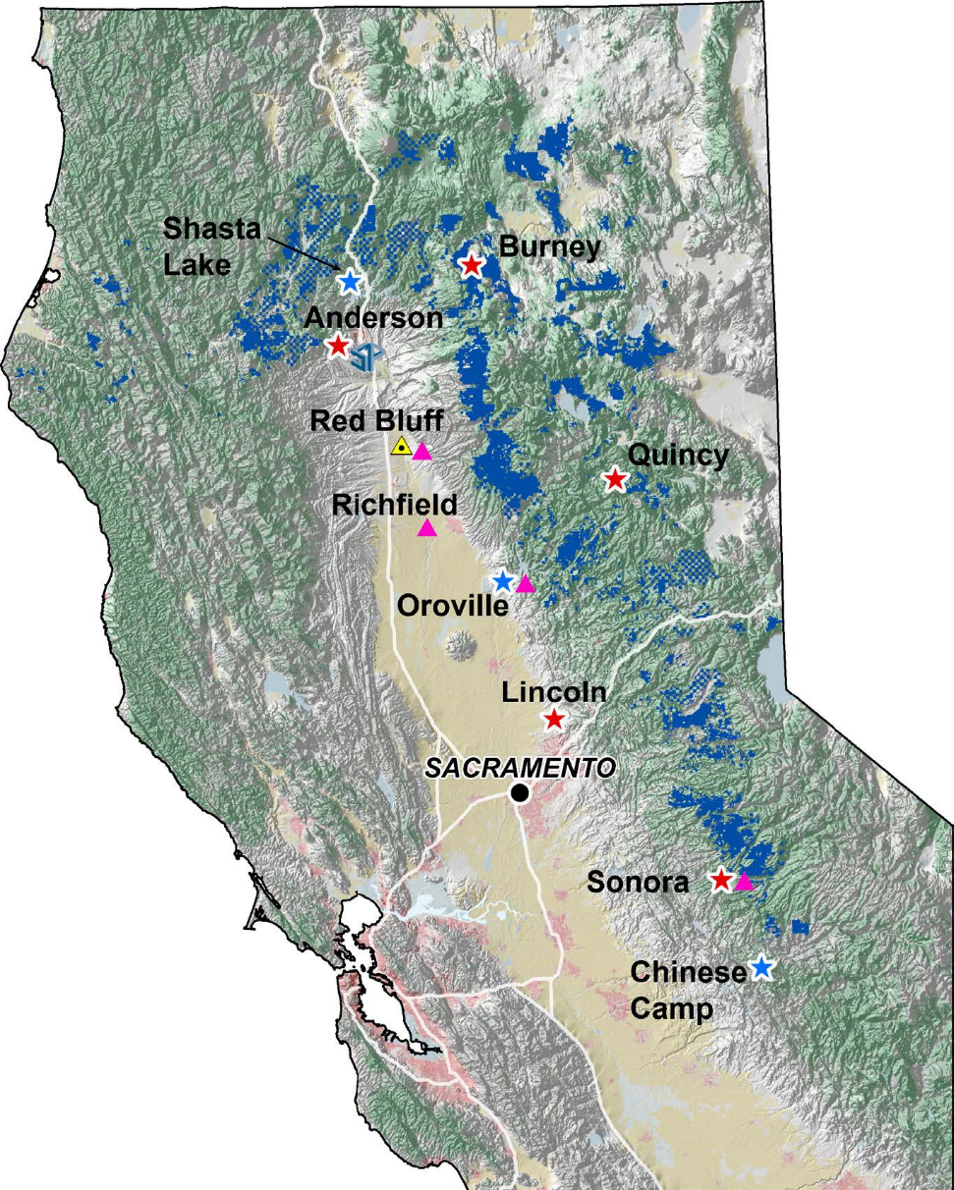

SPI CALIFORNIA FORESTLANDS
GROWING FORESTS FOR OUR FUTURE
1.8 MILLION ACRES

Slide 3
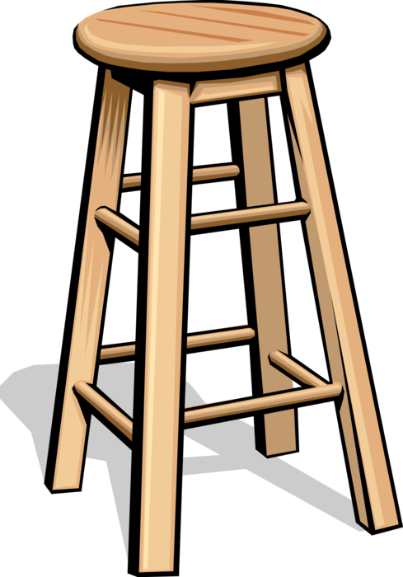
FOUR-LEGGED STOOL
Fuels Reduction & Management
Wildfire Suppression Tactics
Post-Fire Recovery & Restoration
Infrastructure
GROWING FORESTS FOR OUR FUTURE

Slide 4
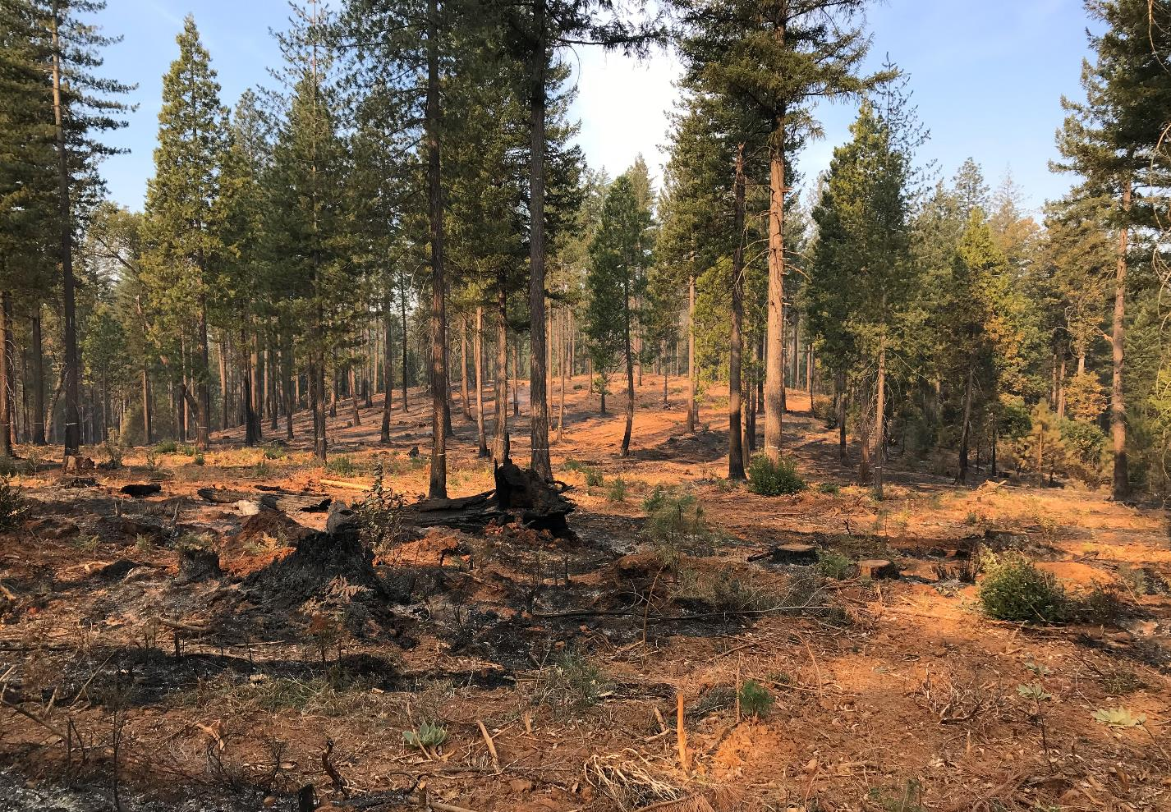
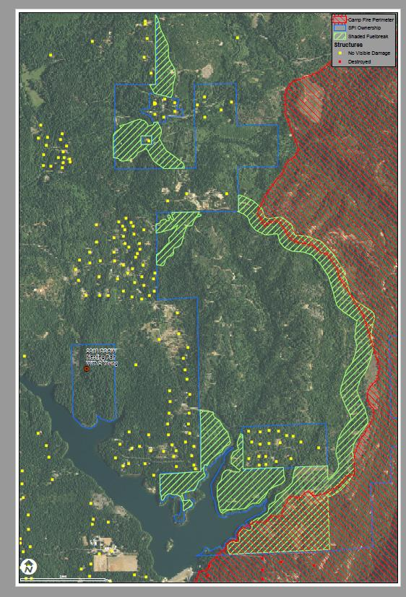
Fuels Reduction & Forest Management
GROWING FORESTS FOR OUR FUTURE

Slide 5
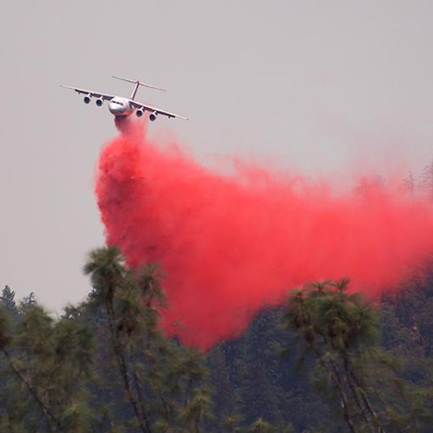
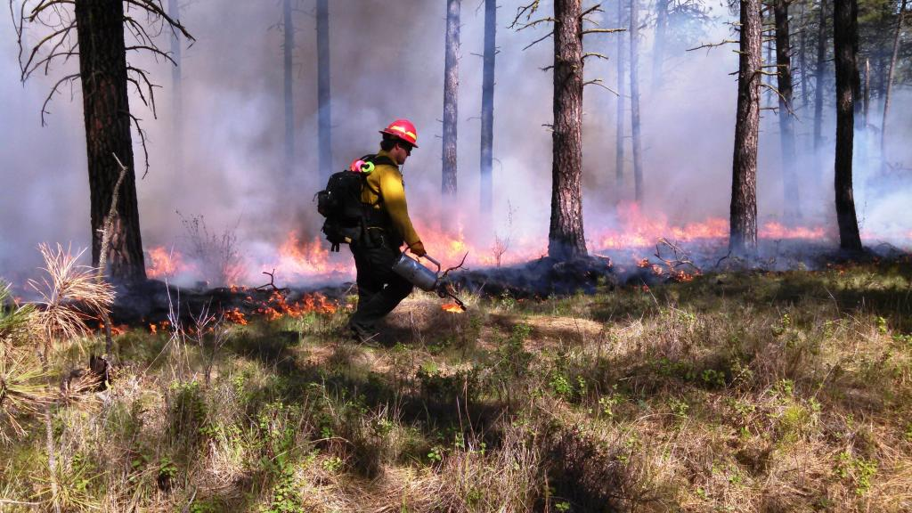
WILDFIRE SUPPRESSION TACTICS
GROWING FORESTS FOR OUR FUTURE

Slide 6
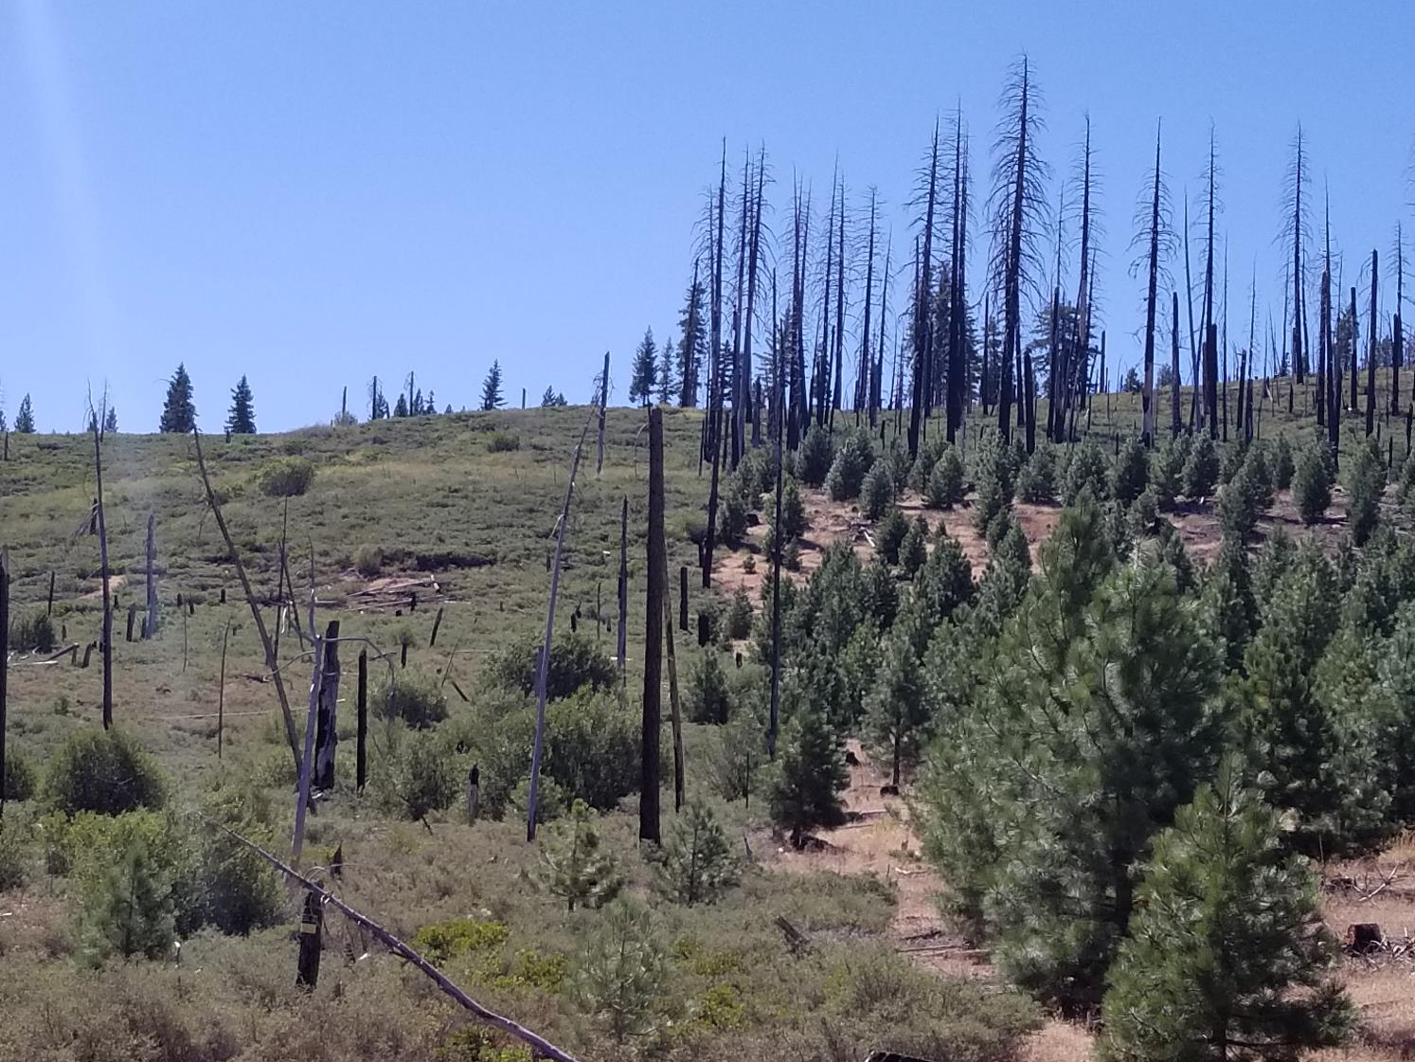
POST-FIRE RECOVERY

Slide 7
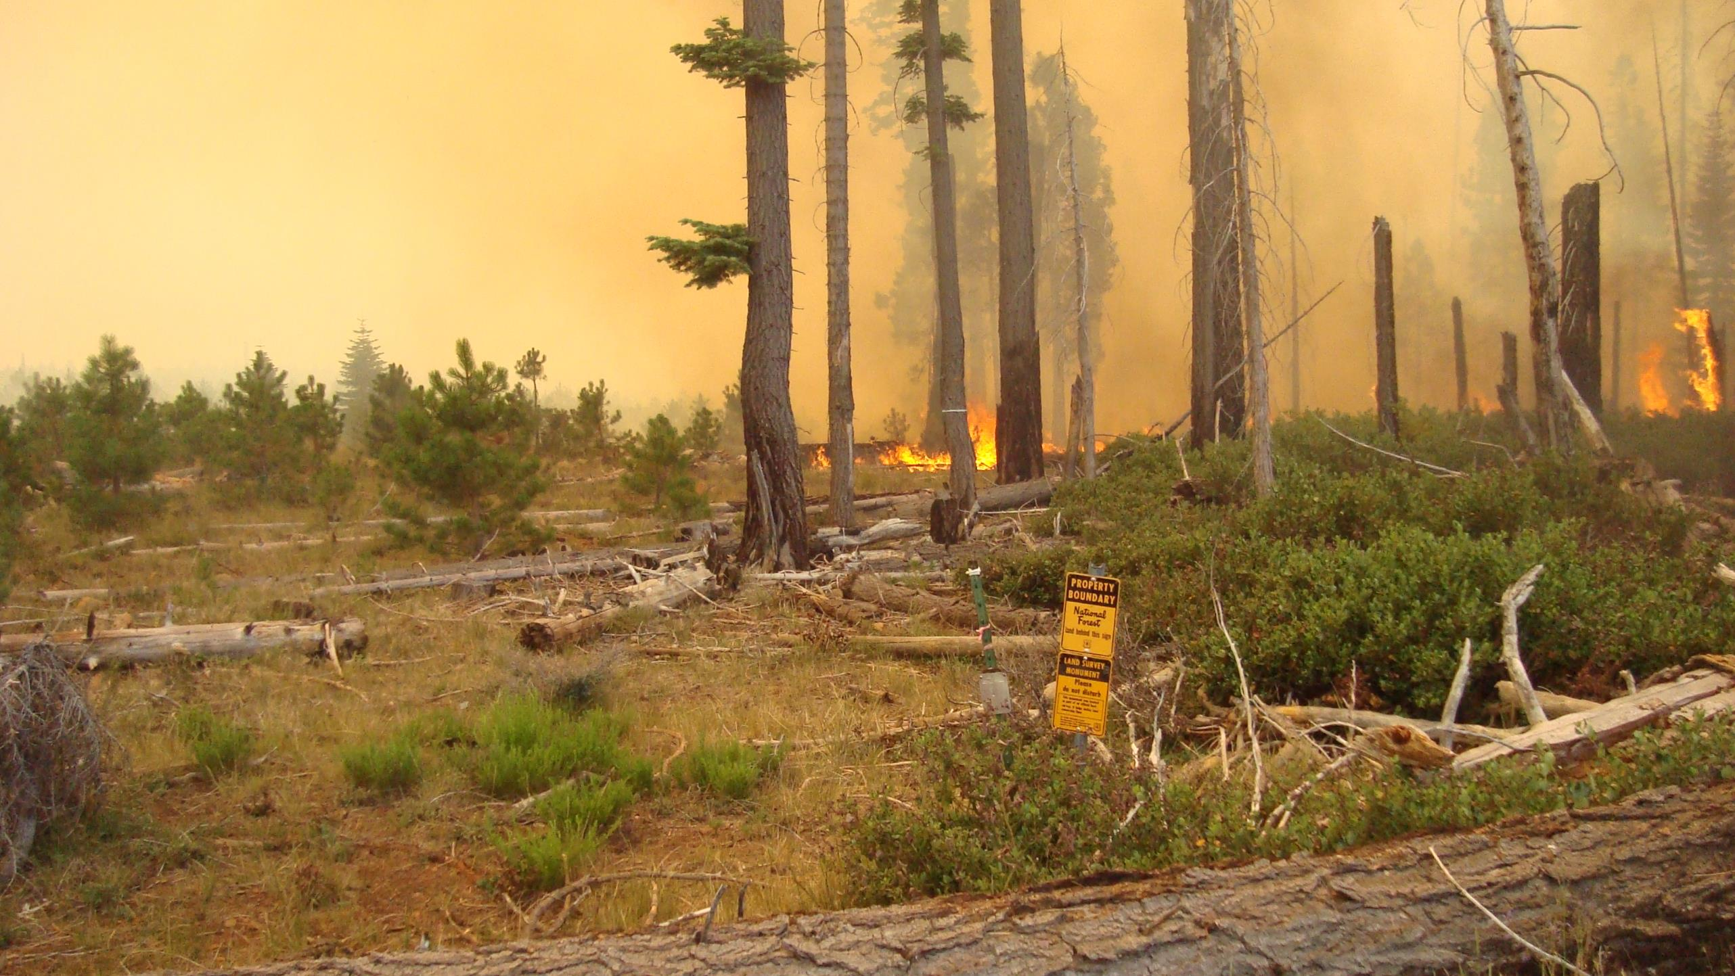
POST-FIRE RECOVERY
GROWING FORESTS FOR OUR FUTURE

Slide 8
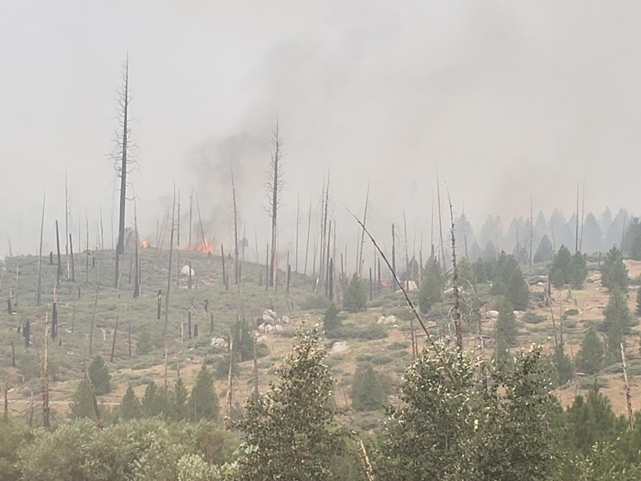
POST-FIRE RECOVERY
GROWING FORESTS FOR OUR FUTURE

Slide 9
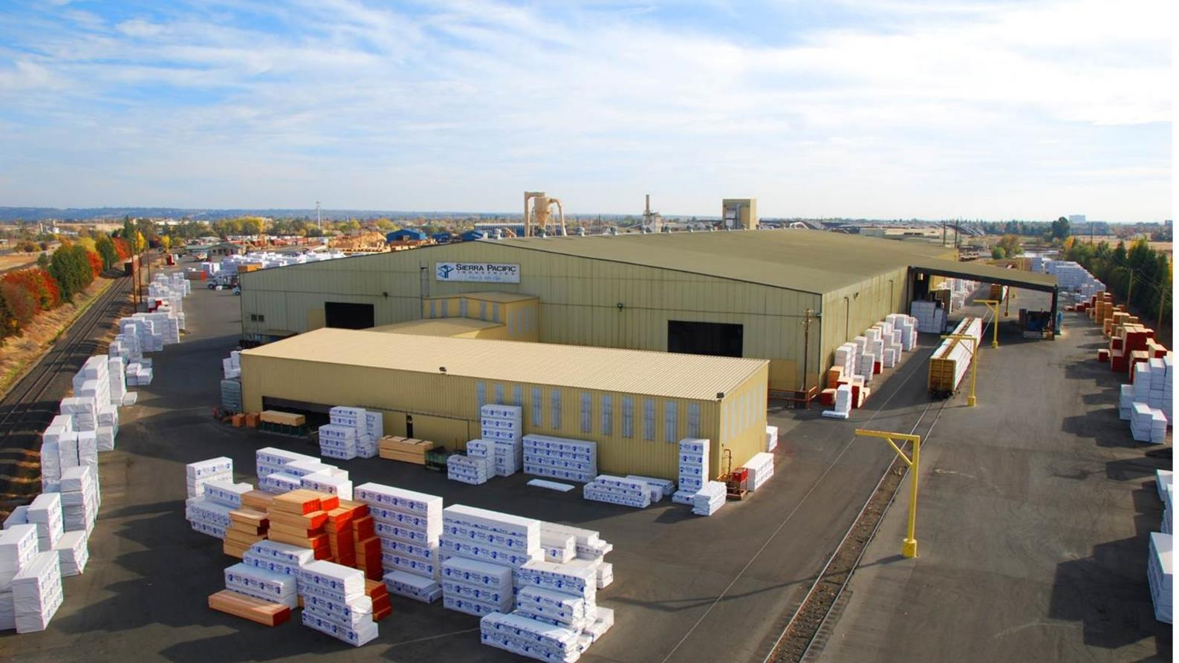
INFRASTRUCTURE
GROWING FORESTS FOR OUR FUTURE

Slide 10
QUESTIONS?
GROWING FORESTS FOR OUR FUTURE

